Slide 1

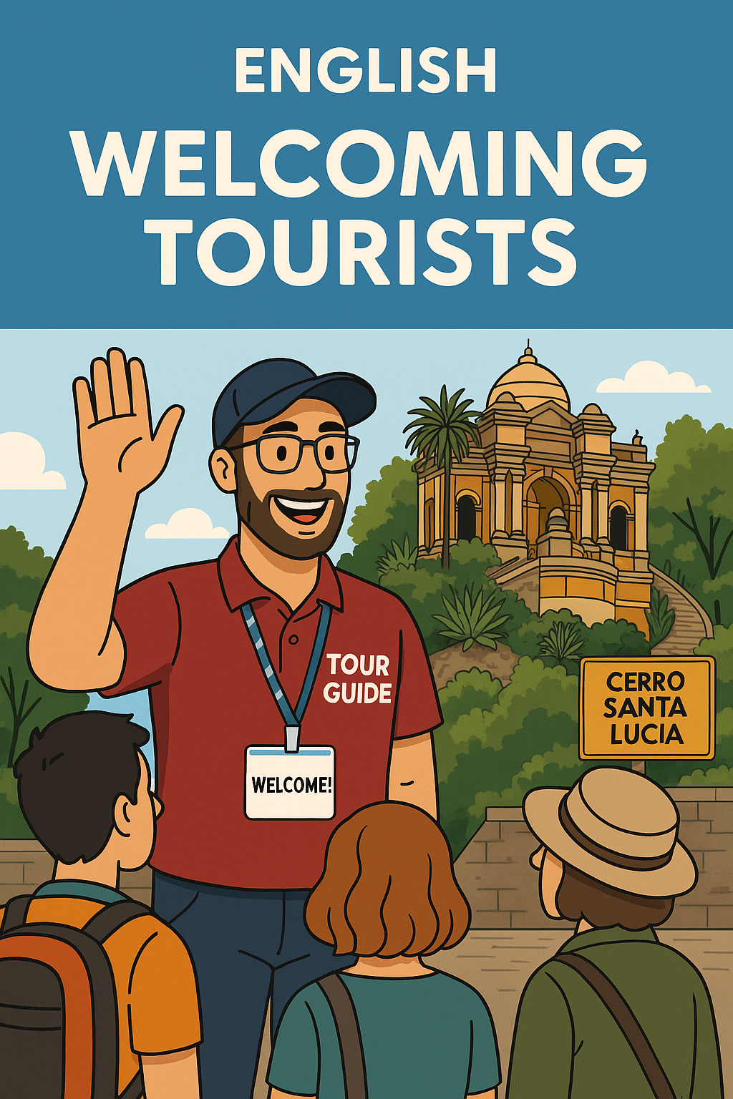
UNIT 1: Recibiendo y saludando a turistas.
By teacher Jeannete.
CONTENTS OF THE LESSON:
Talking about who I am and what I do (review).
Arrivals.
Welcoming the guests.
SKILLS TO PRACTICE:
Reading
Listening
Speaking
Grammar in use.
Vocabulary in use.

Slide 2
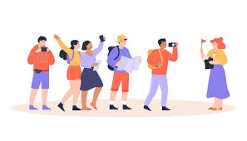
Talking about who I am and what I do, in front of passengers (pax)
Hello everyone!
Welcome and thank you for joining the tour today. My name is Jenny, and I’ll be your guide during this journey. I’m really happy to be here with you and I hope we’ll have a great time together.
Let me tell you a little about myself. I’m a professional tour guide, and I’ve been working in the tourism industry for over 5 years. I started out because I’ve always loved history, culture, and meeting people from all over the world. Being a guide allows me to combine all of that—while helping visitors discover the beauty and stories of this amazing place.
I’m originally from Pucón, and I speak English and Portuguese. I’m passionate about storytelling, and one of my favorite things is seeing people connect with the places we visit—not just through facts, but through local traditions, legends, and everyday life.
Over the years, I’ve worked in various destinations, including San Pedro de Atacama, Rapa Nui and Los Lagos region, guiding everything from city tours and nature walks to cultural experiences and adventure trips. These experiences have taught me how to adapt to different groups, keep things fun and interesting, and make sure everyone feels comfortable and included.
Some of my main strengths as a guide are:
I’m good at keeping excellent communication and interpersonal skills
I know how to go deep into knowledge of local history and culture.
I enjoy having a good sense of humor and patience.
And above all, real passion for what I do.
During our time together, feel free to ask questions, take pictures, and most importantly—enjoy yourselves! I’m here to make sure you have a safe, informative, and unforgettable experience. Once again, welcome! Let’s get started!

Slide 3
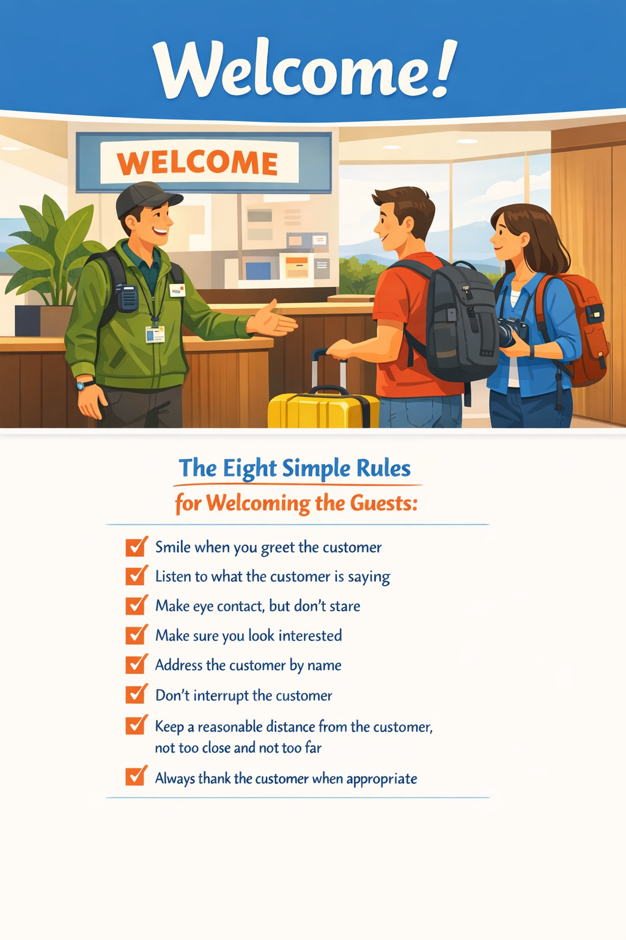


An introduction in working in tourism.
Tourism is about encounters, encounters with people, with places and with experiences. And the most important encounter is the first one: arrivals and greetings. Get that one right and the rest is much more easier.
Arrival encounters can take place anywhere: at the airport, at the hotel, at the campsite, in the restaurant, on the bus. Wherever it takes place the rules are the same:
Be prepared
Be interested
Be helpful
Be yourself
Smile

Slide 4
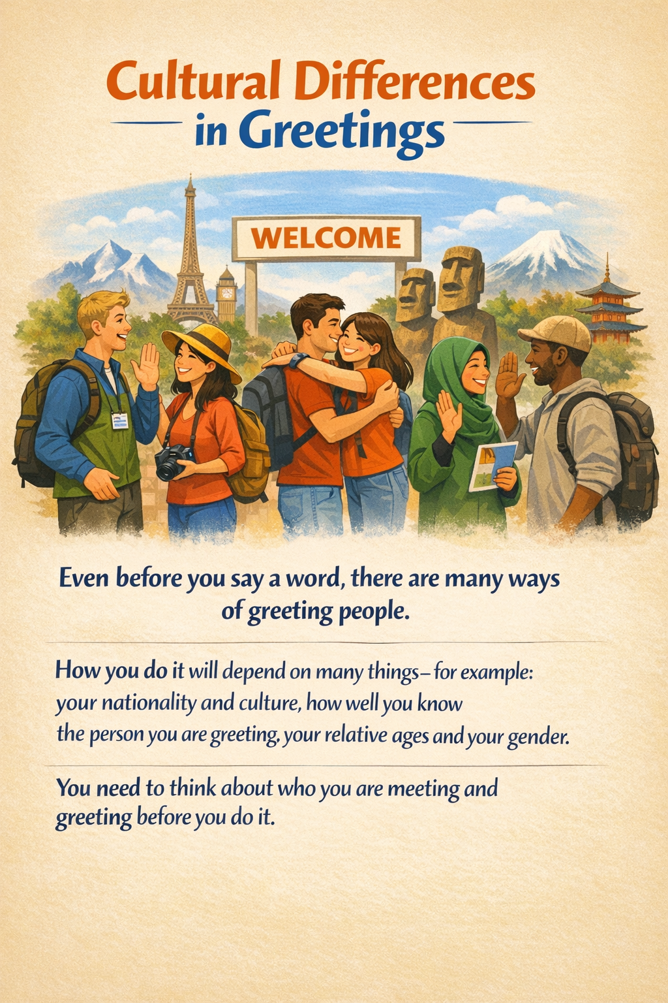
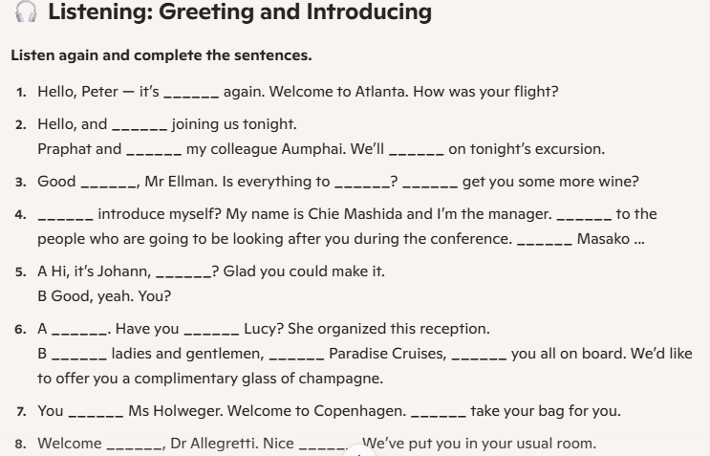
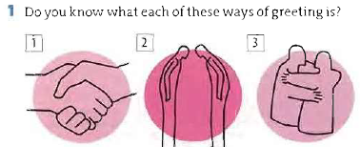
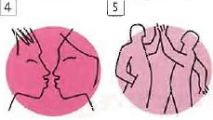

Slide 5
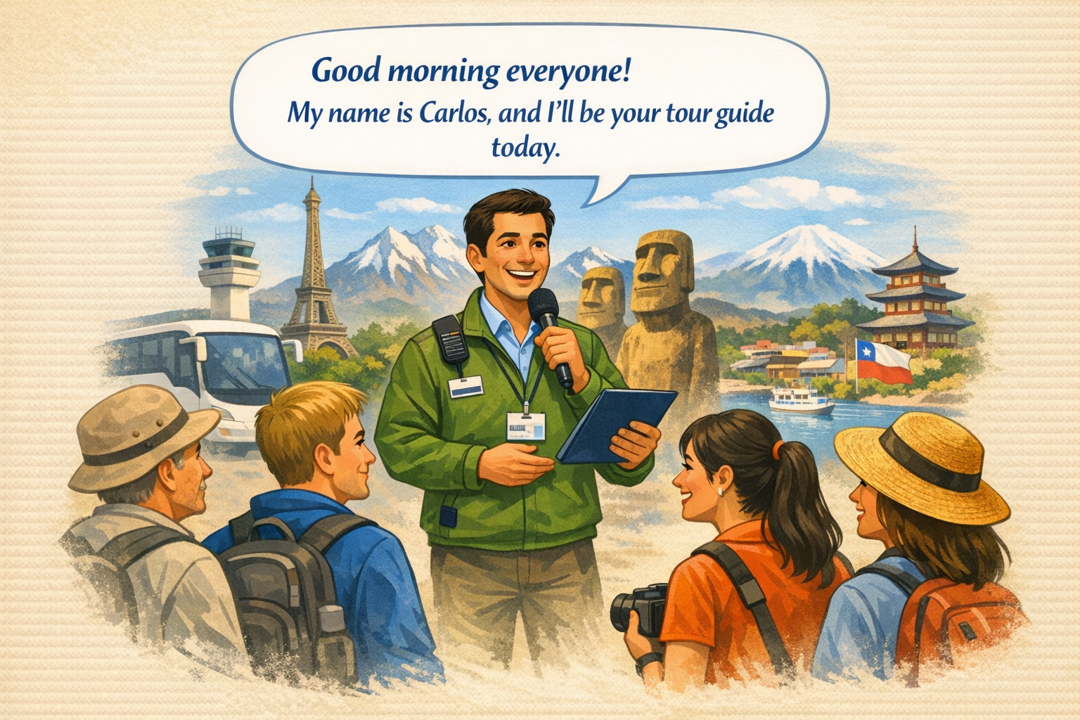
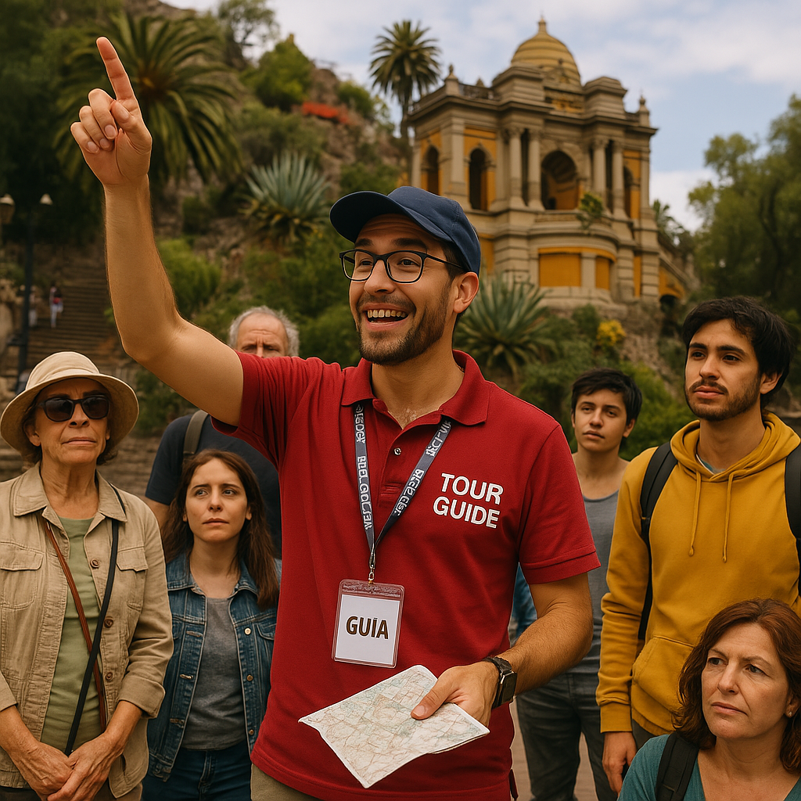
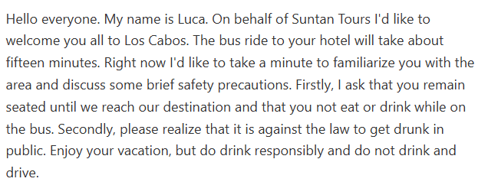
WELCOMING TOURISTS.
"Hello, everyone! Welcome to our tour. I'm gladto have you with us today as we explore the beautiful sights of Chile. If you have any questions or need assistance, feel free to ask. Let's make this journey memorable!"
"Good morning, travelers! My name is Pedro, and I'll be your guide today. We're about to discover some incredible spots, so get ready for an unforgettable journey. If you need anything or have questions, don't hesitate to ask. Let's make it a great day!"

Slide 6
🚌 At the beginning of the tour
we may say…
Greetings and Welcoming Phrases.
"Good morning, everyone! Welcome aboard!"
"Hello and welcome! I'm Aline, your guide for today."
"Hi there! I’m so glad to see you all. Thanks for joining us!"
"Welcome to our tour! We’re going to have an amazing time together."
"It’s a pleasure to have you with us today. Get ready for a great adventure!"
🧑‍✈️ Phrases to introduce your partner or the driver.
"With us today is our fantastic driver, Luis, who will make sure we travel safely and comfortably."
"Also joining us is my colleague Alberto, who will be assisting during the tour."
"Say hello to Pamela our amazing driver. She’s the one making this journey possible!"
"I’m not alone today—Estephany is here with me, and we’ll both be taking care of you during the tour."
🙋‍♂️ Phrases to introduce yourself as the guide in charge.
"Hi everyone, my name is Claudio], and I’ll be your tour guide today."
"I'm Diego, and I’ll be leading you through today’s adventure."
"Nice to meet you all! I’ll be your guide as we explore this amazing destination."
What other ways do you know to greet and welcome people? Can we mix phrases and do more expressions?

Slide 7
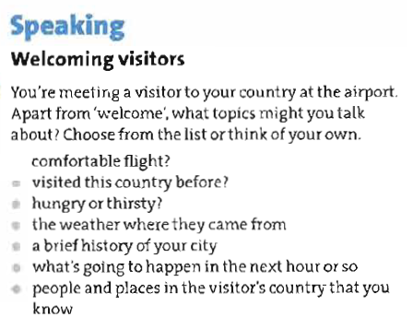
Homework task:

