Slide 1

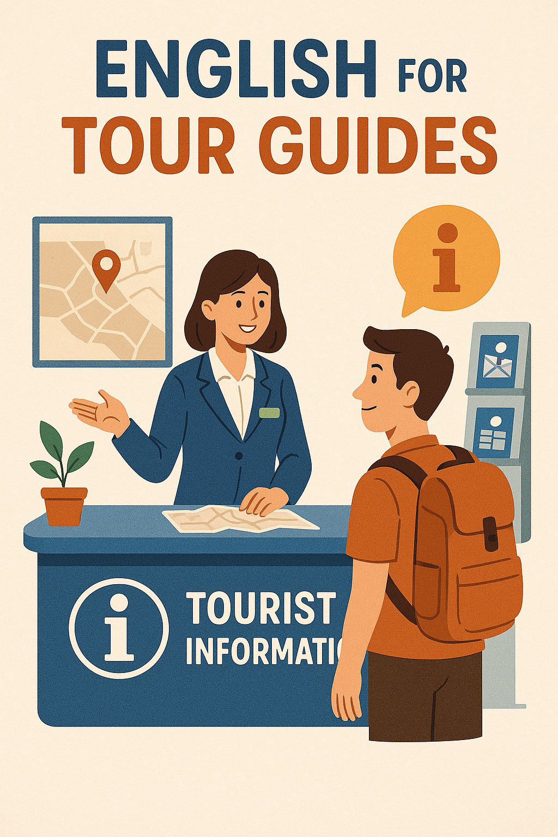
English for tour guides by Miss Jeannete Uribe G.
jeannete.uribe@lenguaagil.cl
Unit 2: Describiendo y recomendando destinos turísticos.
CONTENTS OF THE LESSON:
Tourist Information services
Accommodation types.
A hotel, a place to stay.
SKILLS TO PRACTICE:
Reading
Listening
Speaking
Grammar in use.
Vocabulary in use.

Slide 2
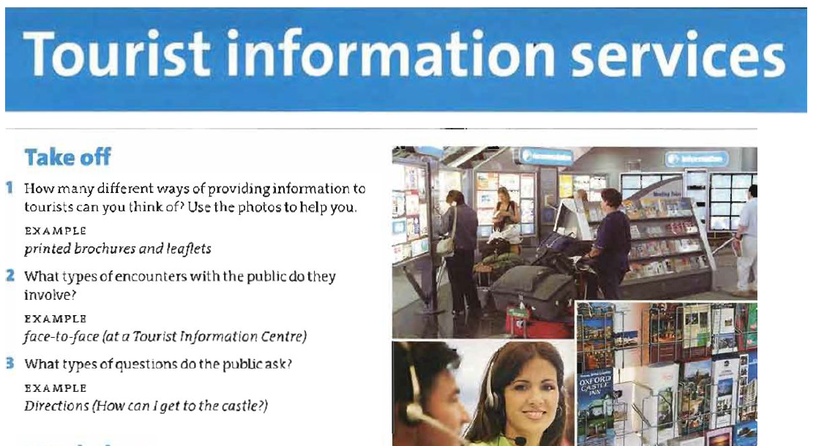


Slide 3
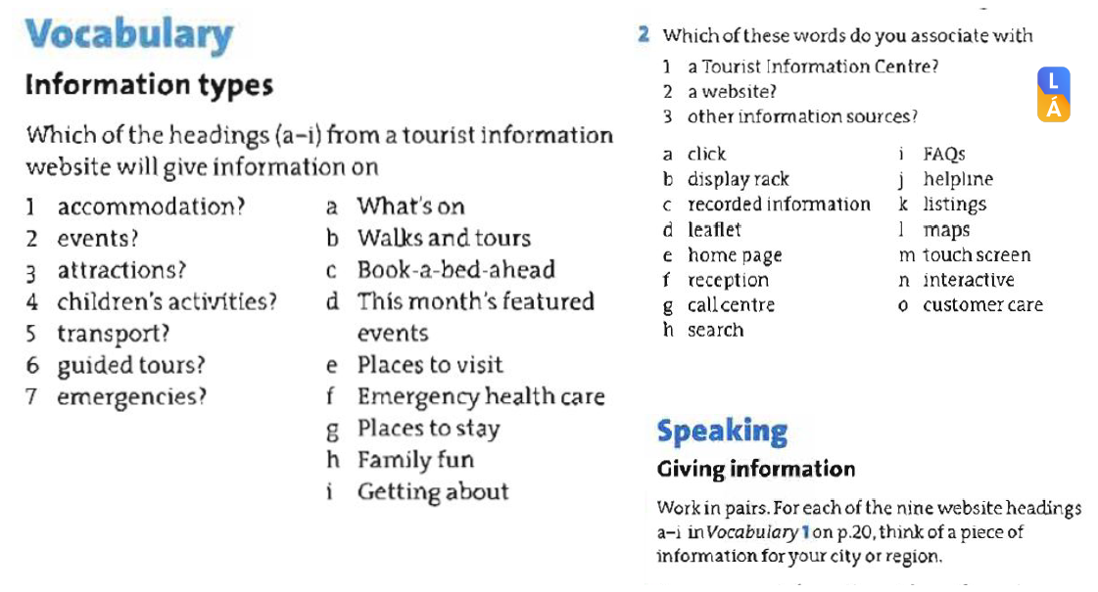

Slide 4

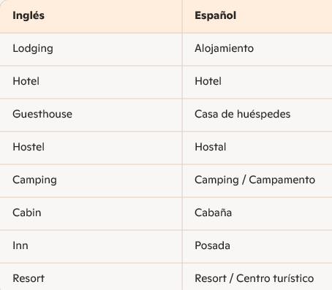
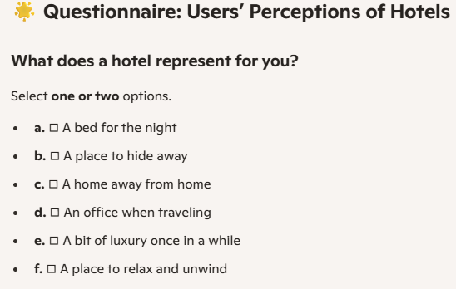
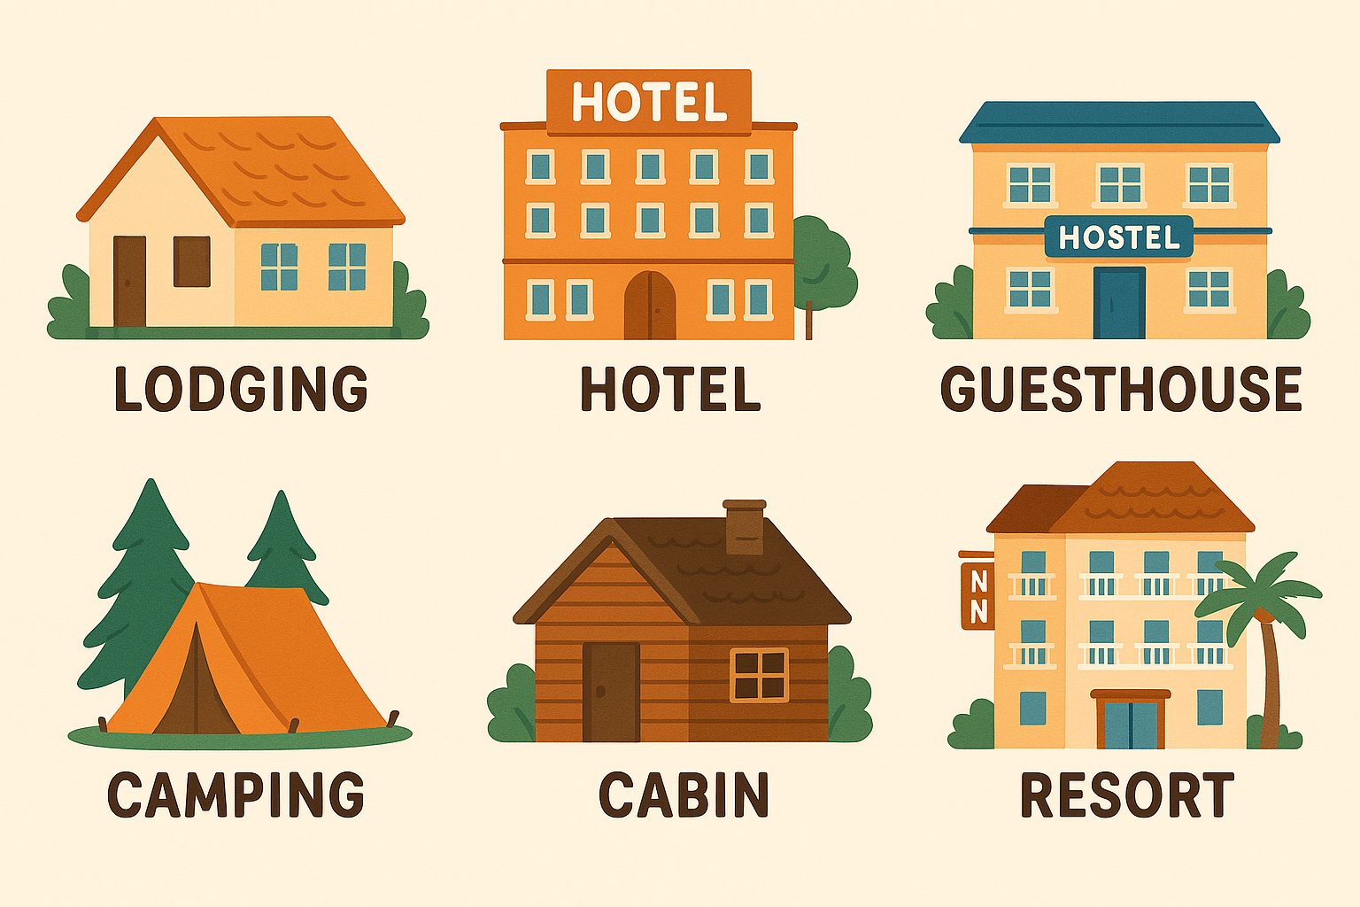


Slide 5
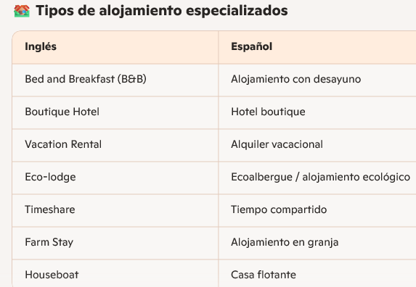

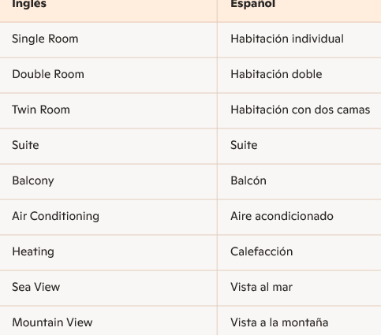
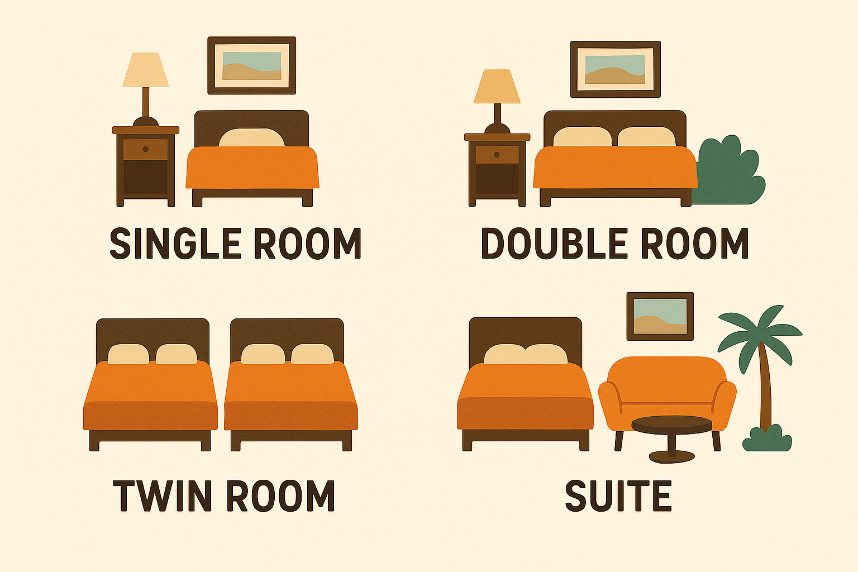

Slide 6
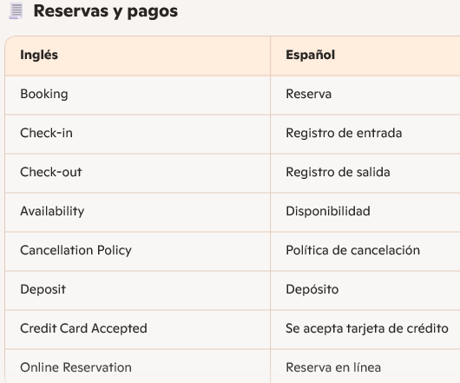
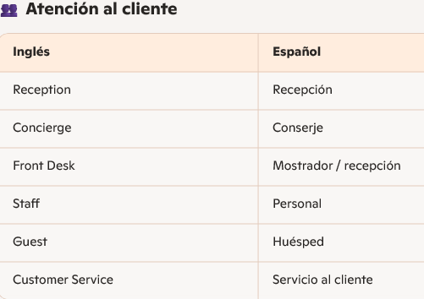

Listen to “The structure of a hotel” conversation.

Slide 7

Hotel Information:
Make a list of all the services a hotel can offer in the following areas.
Eating and drinking.
Recreation and relaxation.
Business services.
Room service and facilities.
Local transport and other services.

