Slide 1

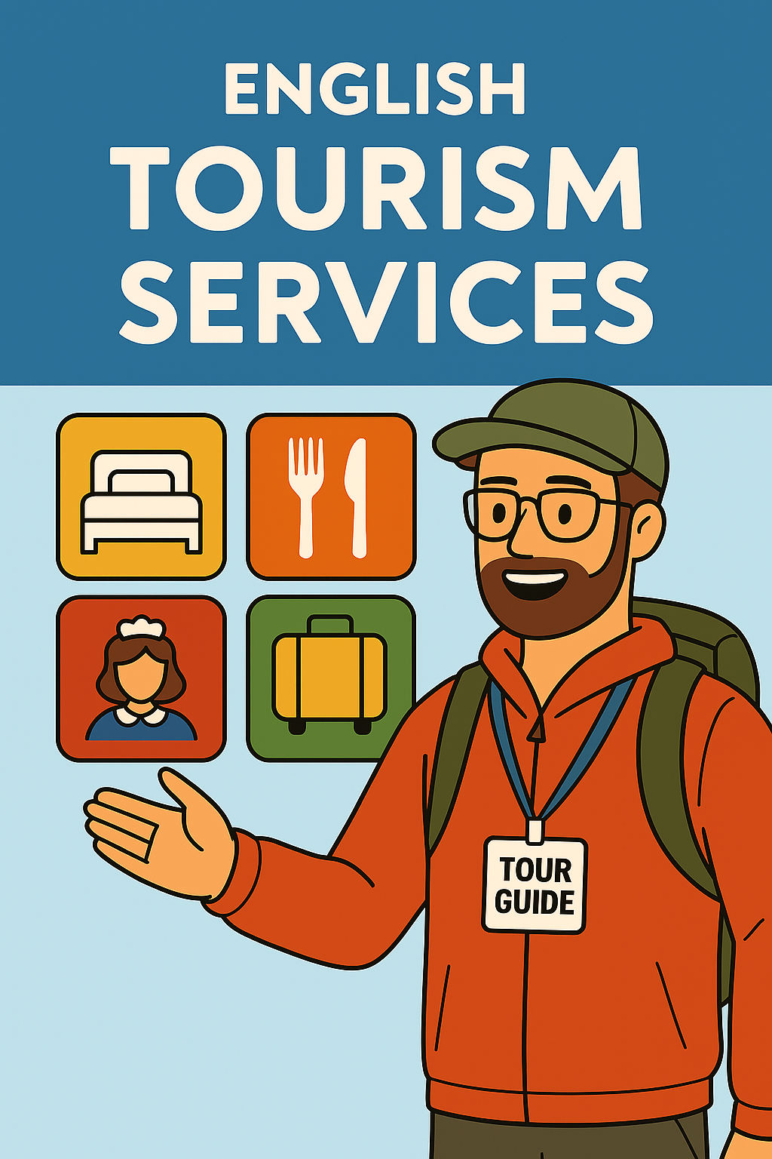
English for tour guides by Miss Jeannete Uribe G.
jeannete.uribe@lenguaagil.cl
Unit 2: Describiendo y recomendando destinos turísticos.
CONTENTS OF THE LESSON:
A hotel, a place to stay.
Hotel services.
Talking about restaurants as tourist information services.
SKILLS TO PRACTICE:
Reading
Listening
Speaking
Grammar in use.
Vocabulary in use.

Slide 2



Hotel Information:
Make a list of all the services a hotel can offer in the following areas.
Eating and drinking.
Recreation and relaxation.
Business services.
Room service and facilities.
Local transport and other services.

Slide 3
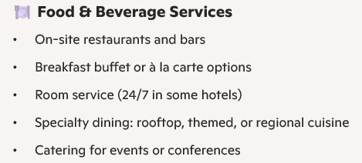
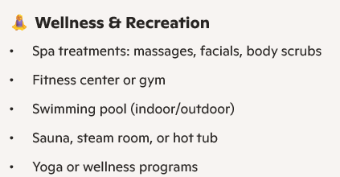
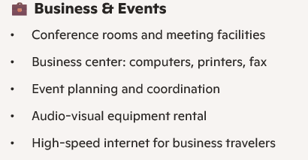
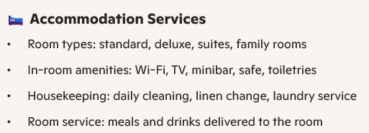
Services in a Hotel.

Slide 4
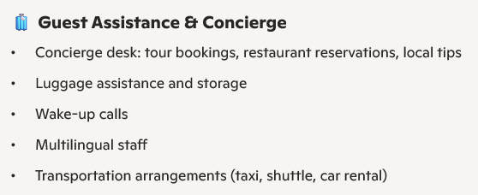
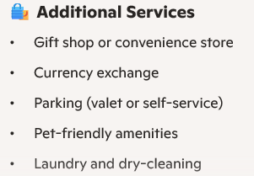
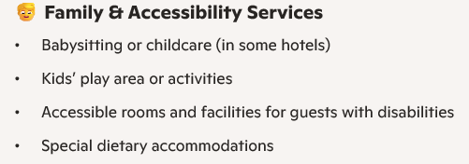
What kind of things may a visitor ask you about accommodations in your area? Make a list.

Slide 5
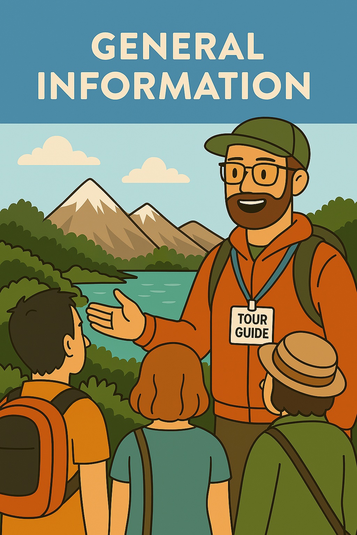
Let’s make a short talk about any hotel information a guest may ask you.
Guest:
Tour guide:
G:
T:

Slide 6
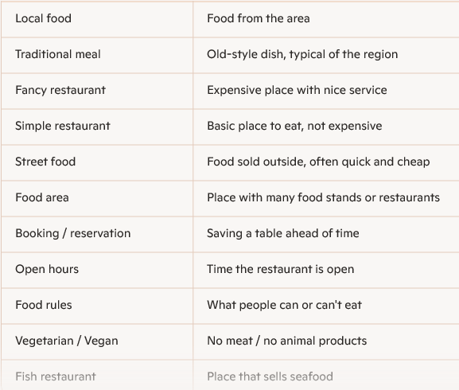
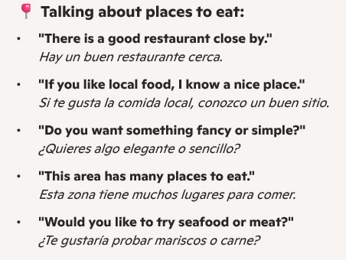
Basic vocabulary related to food places.

Slide 7
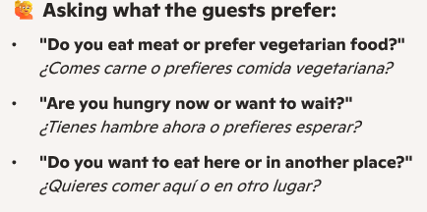
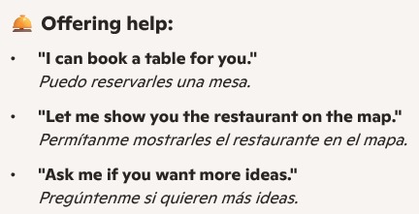
What kind of things may a visitor ask you about places to eat in your area? Make a list.

Slide 8
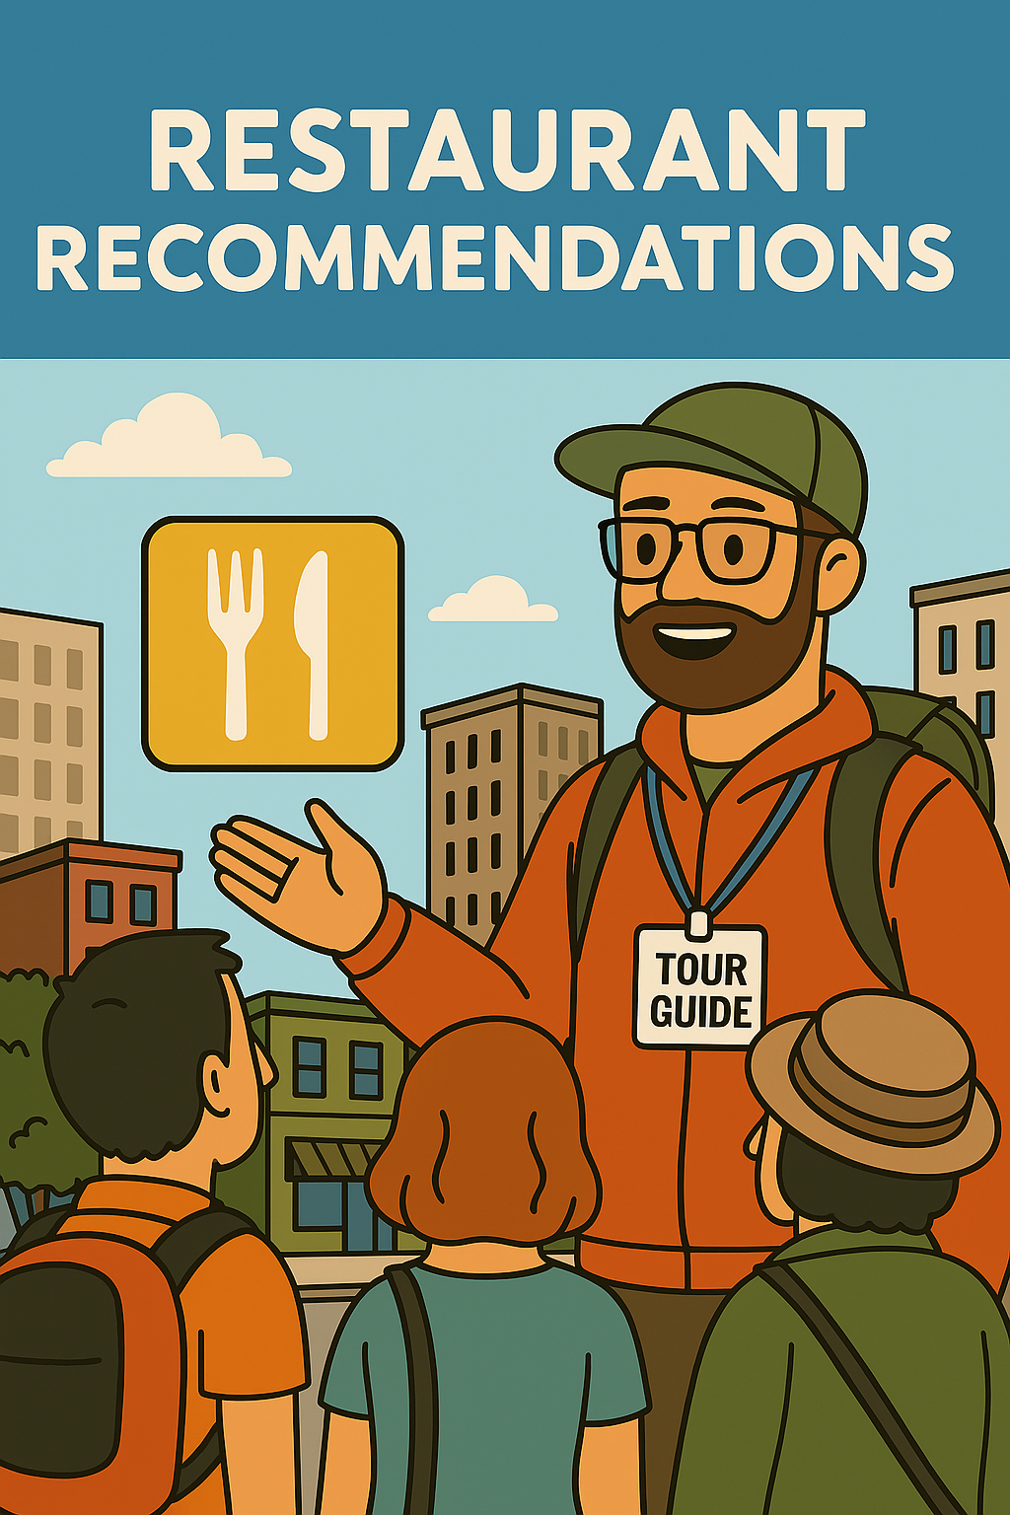
Let’s make a short talk about any information in relation with food places, that a guest may ask you.
Guest:
Tour guide:
G:
T:

