Slide 1

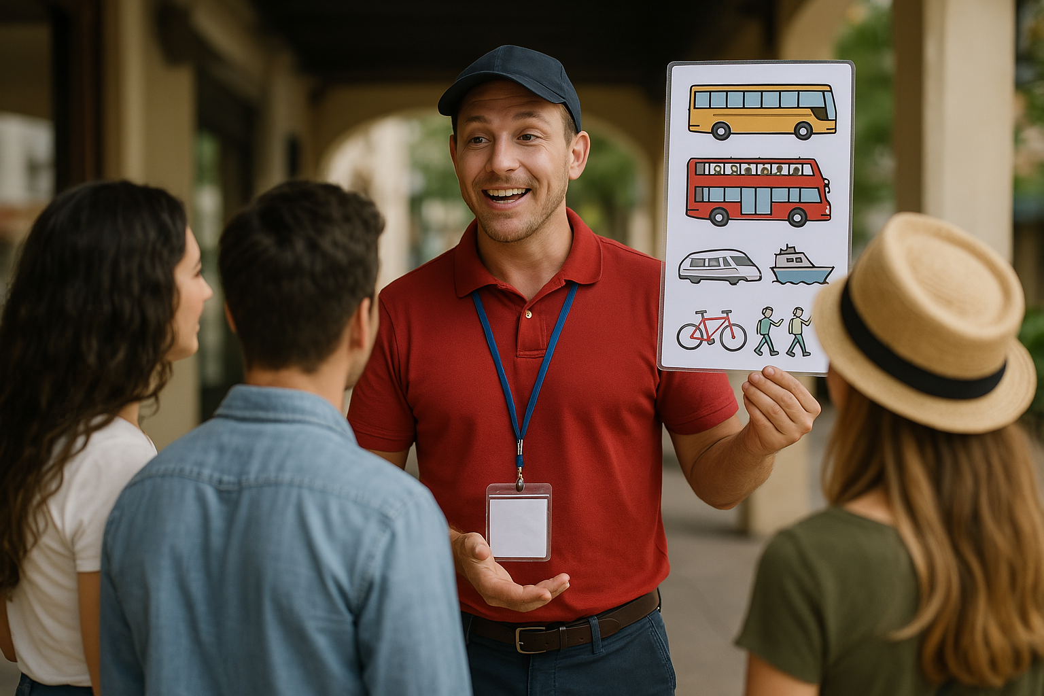
English for tour guides by Miss Jeannete Uribe G.
jeannete.uribe@lenguaagil.cl
Unit 2: Describiendo y recomendando destinos turísticos.
CONTENTS OF THE LESSON:
Giving advice about local transportation and tours.
SKILLS TO PRACTICE:
Reading
Listening
Speaking
Grammar in use.
Vocabulary in use.

Slide 2
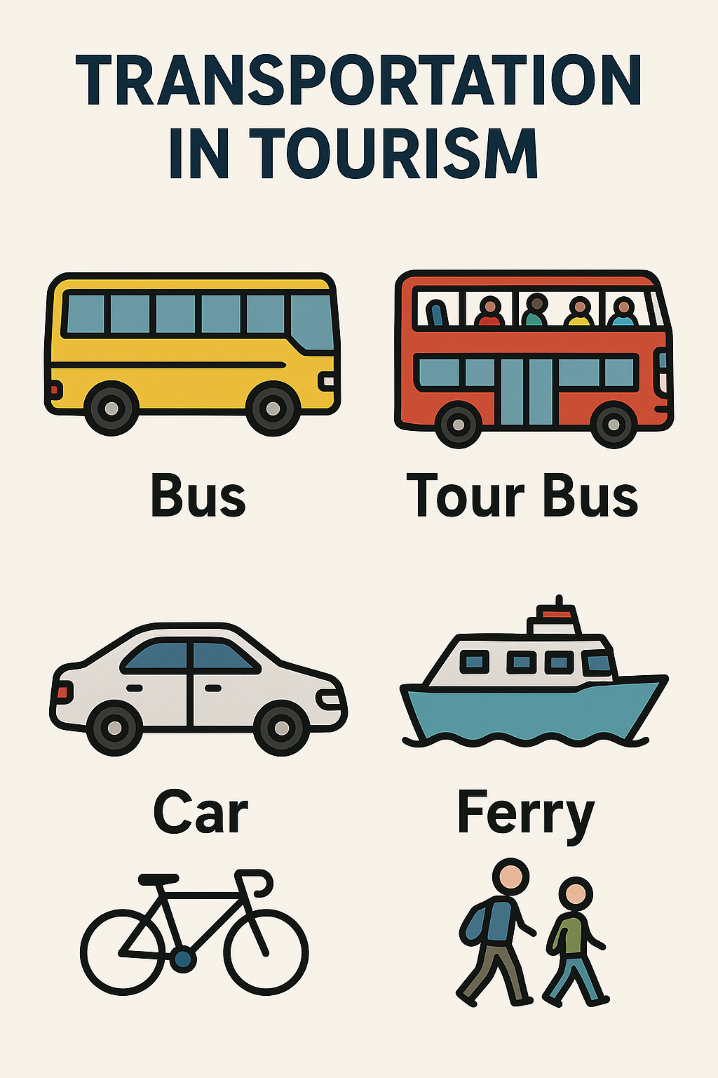
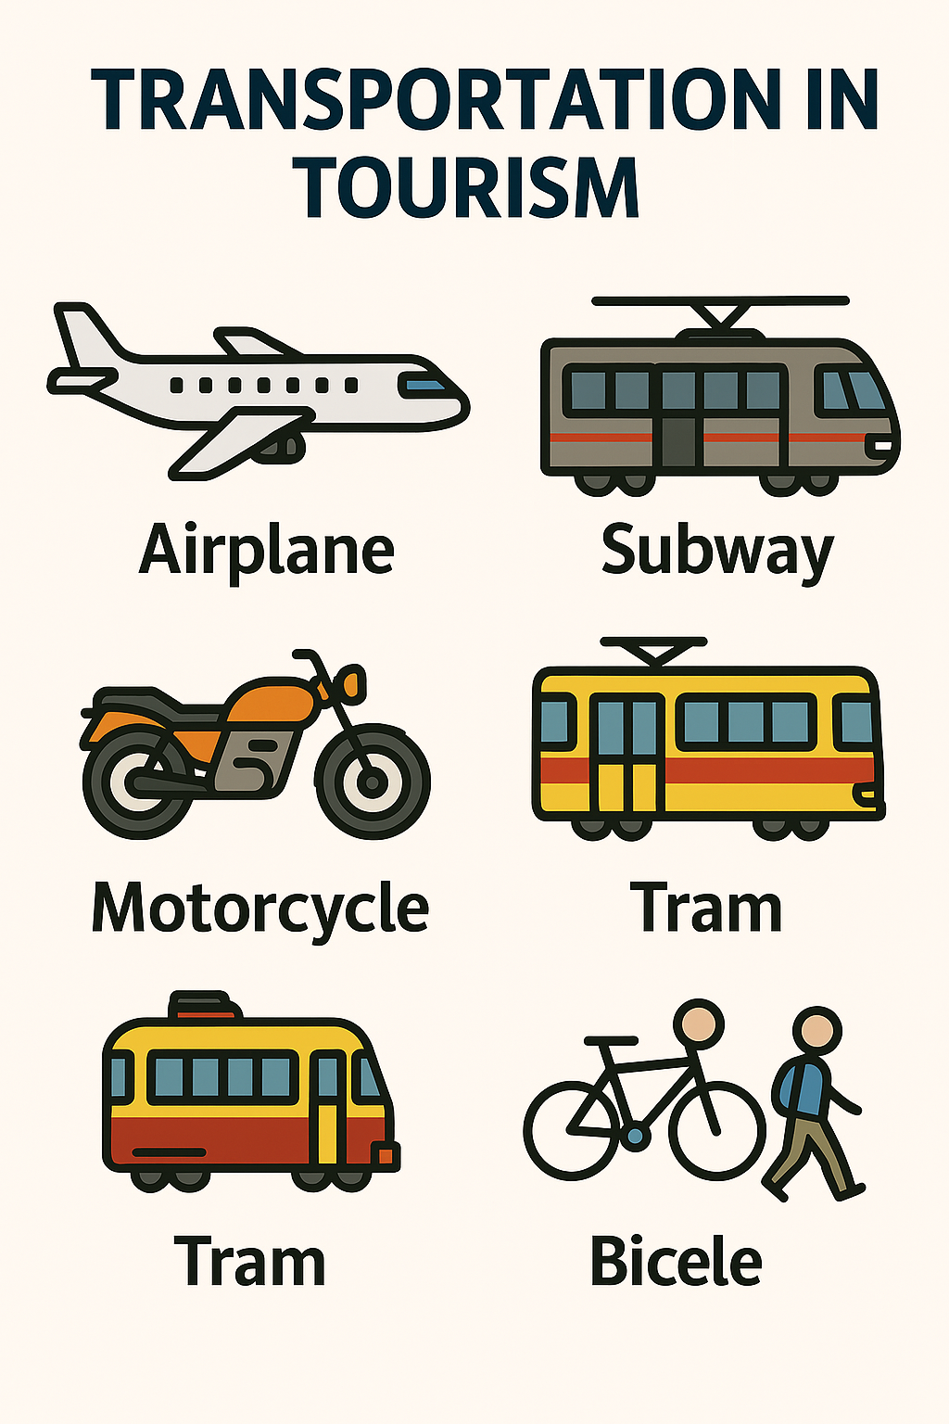


Do you know any other way of moving around a place?
Bicycle

Slide 3
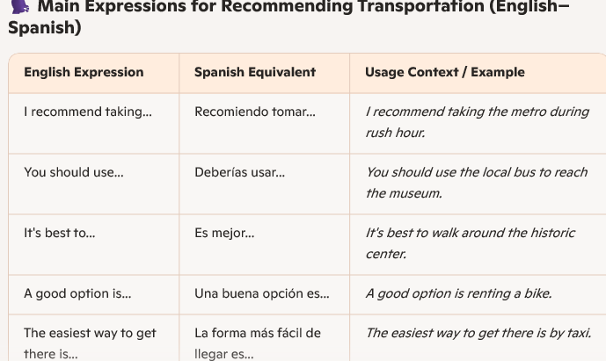

Slide 4
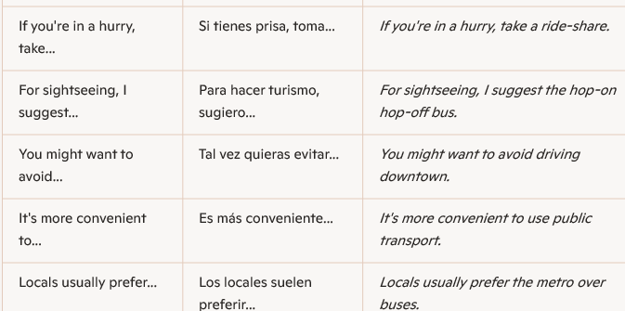

Slide 5
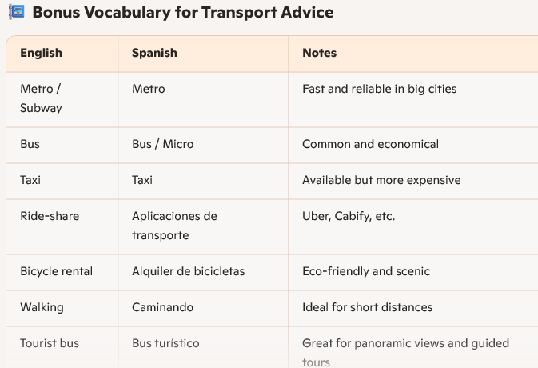

Slide 6
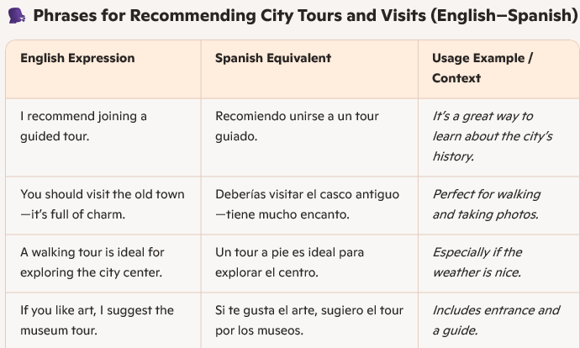
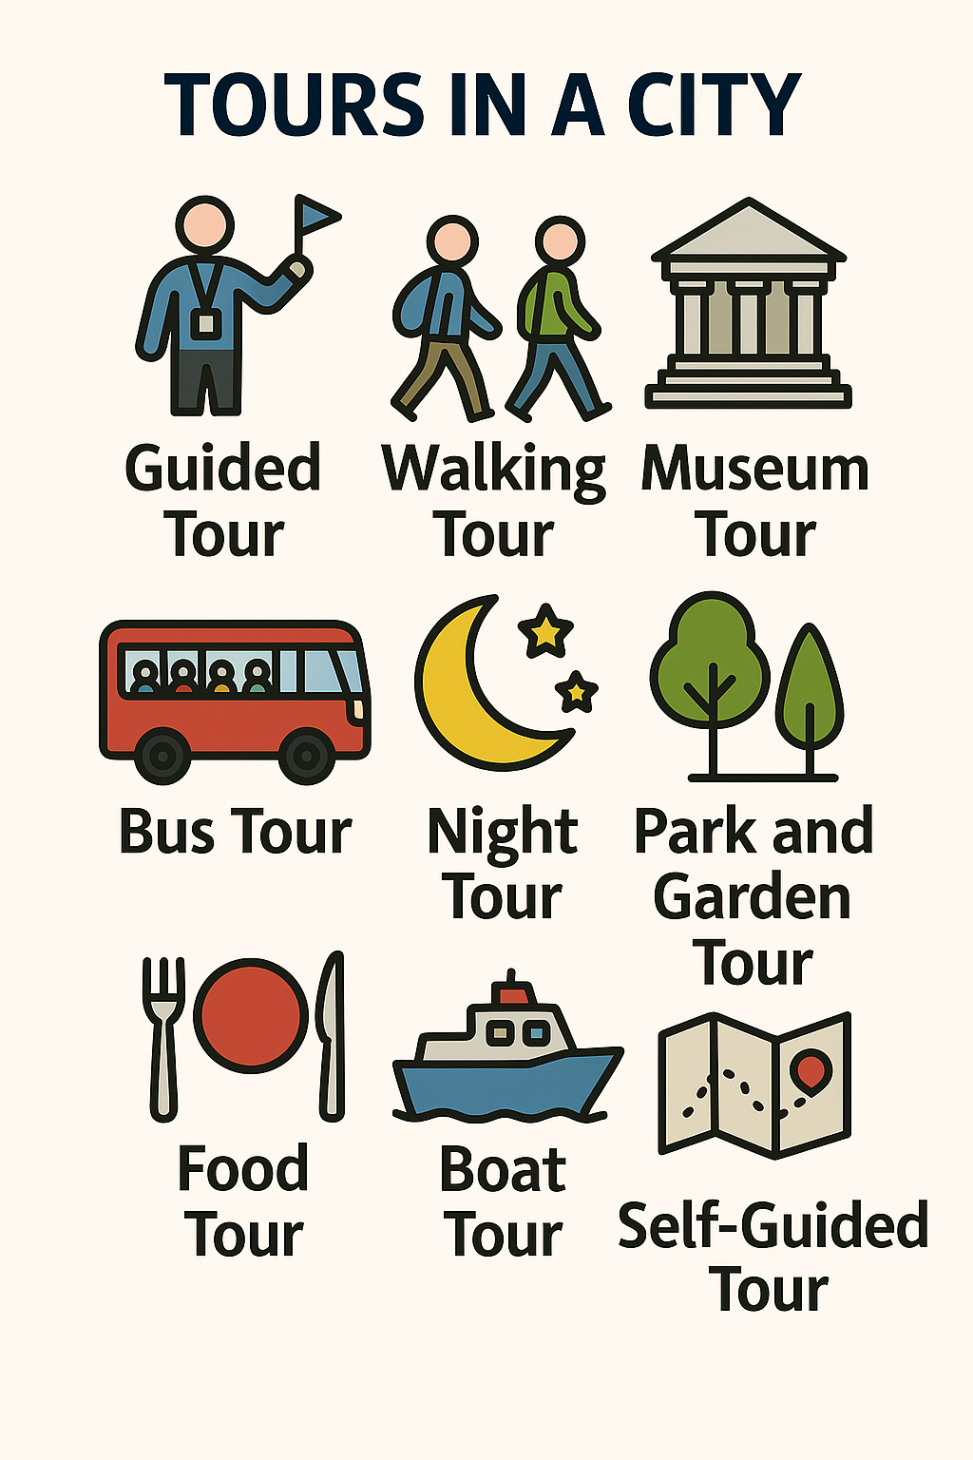

Slide 7
