Slide 1

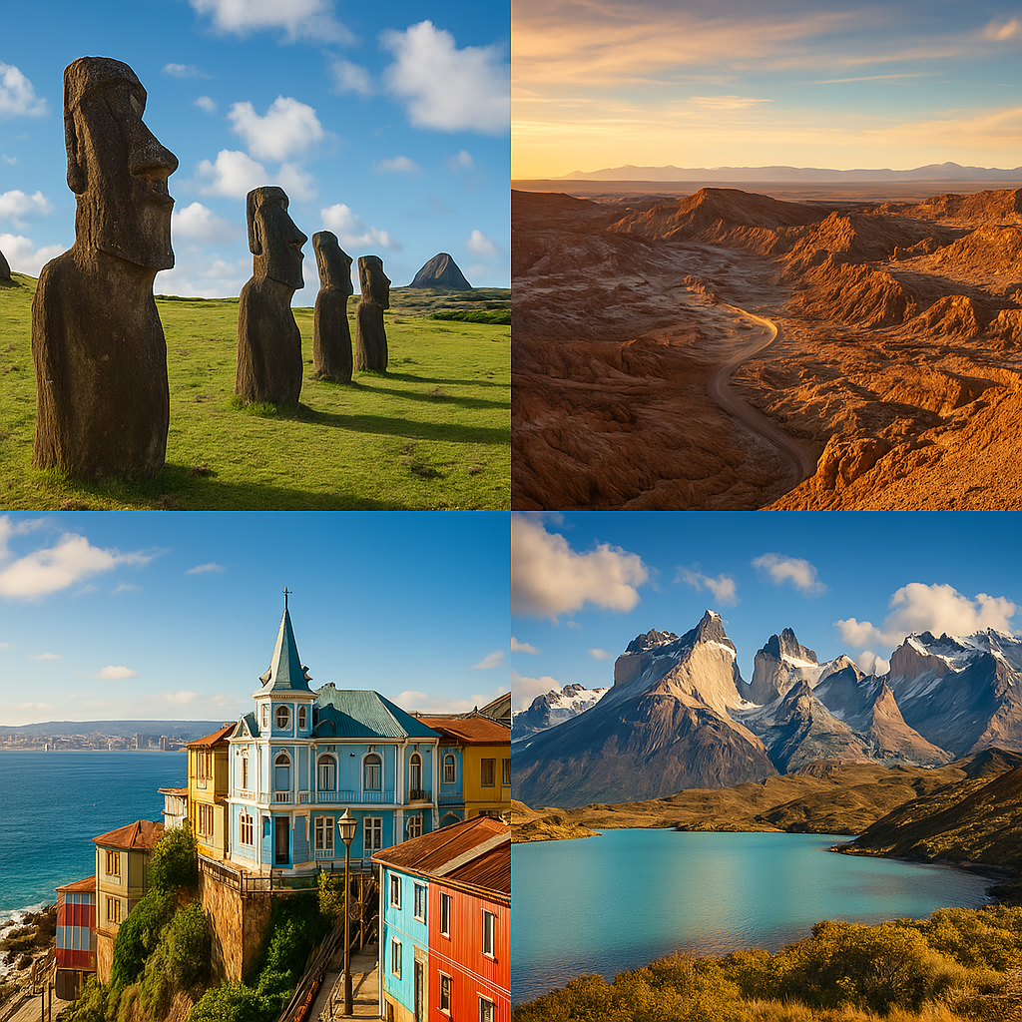
English for tour guides by Miss Jeannete Uribe G.
jeannete.uribe@lenguaagil.cl
Unit 2: Describiendo y recomendando destinos turísticos.
CONTENTS OF THE LESSON:
Tourist attractions and events
Description of destinations and events.
Prepositions of place. Giving directions of landmarks.
Recommending places.
SKILLS TO PRACTICE:
Reading
Listening
Speaking
Grammar in use.
Vocabulary in use.

Slide 2

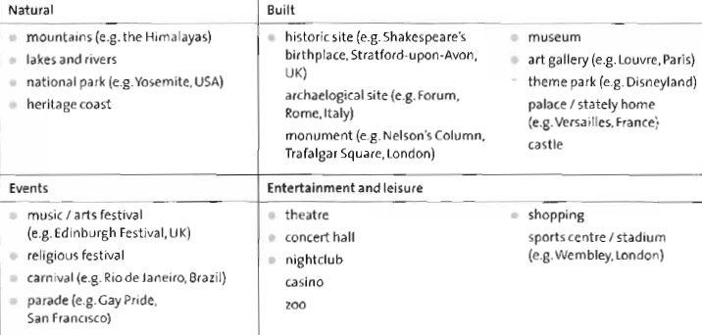
Describing a destination.

Slide 3
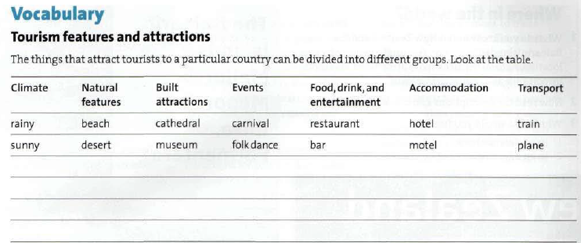
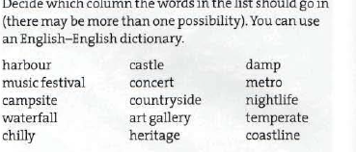

Slide 4
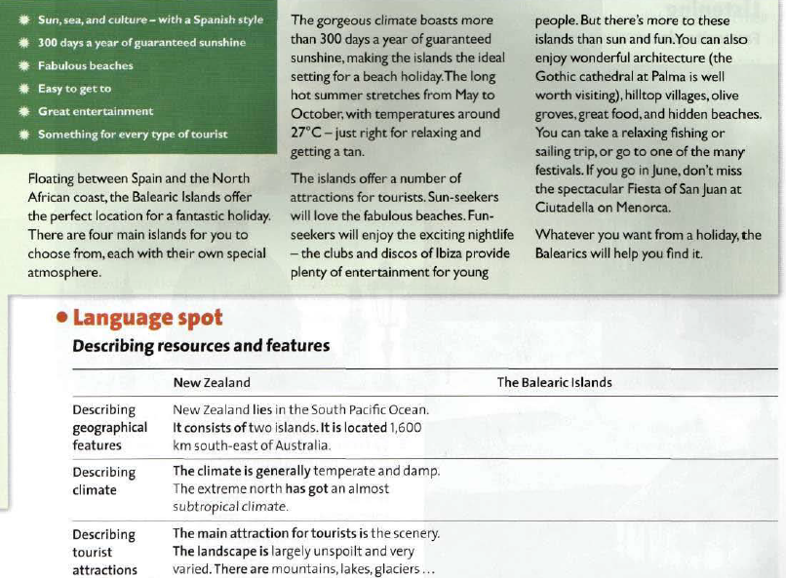

Slide 5
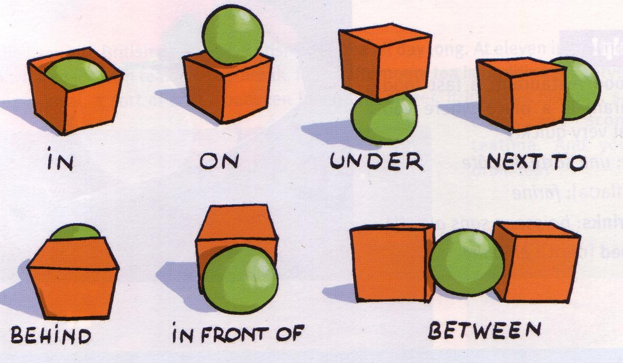
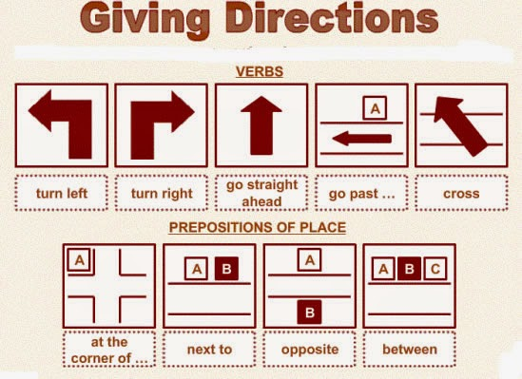

Prepositions of place.
Prepositions of direction.

Slide 6
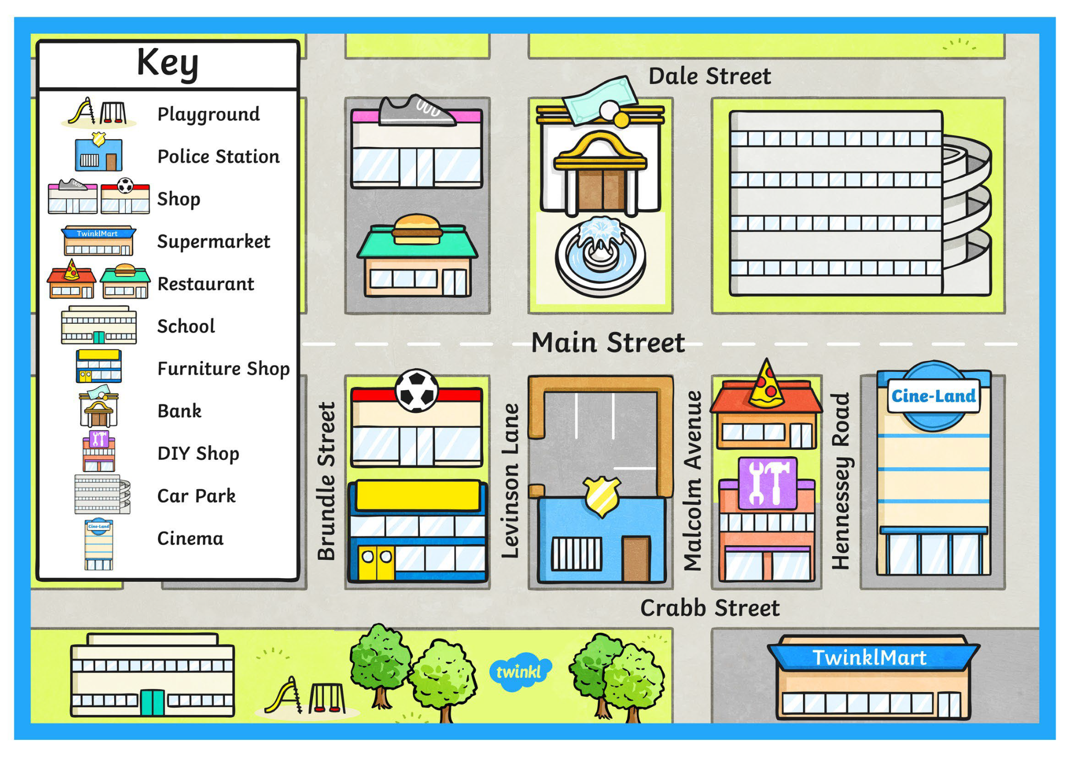

Places in a city.
Where is the bank?
It’s between the restaurant and the school.
It’s between Main and Dale Streets.
Where is the pizza place?
Where is the burger place?

Slide 7
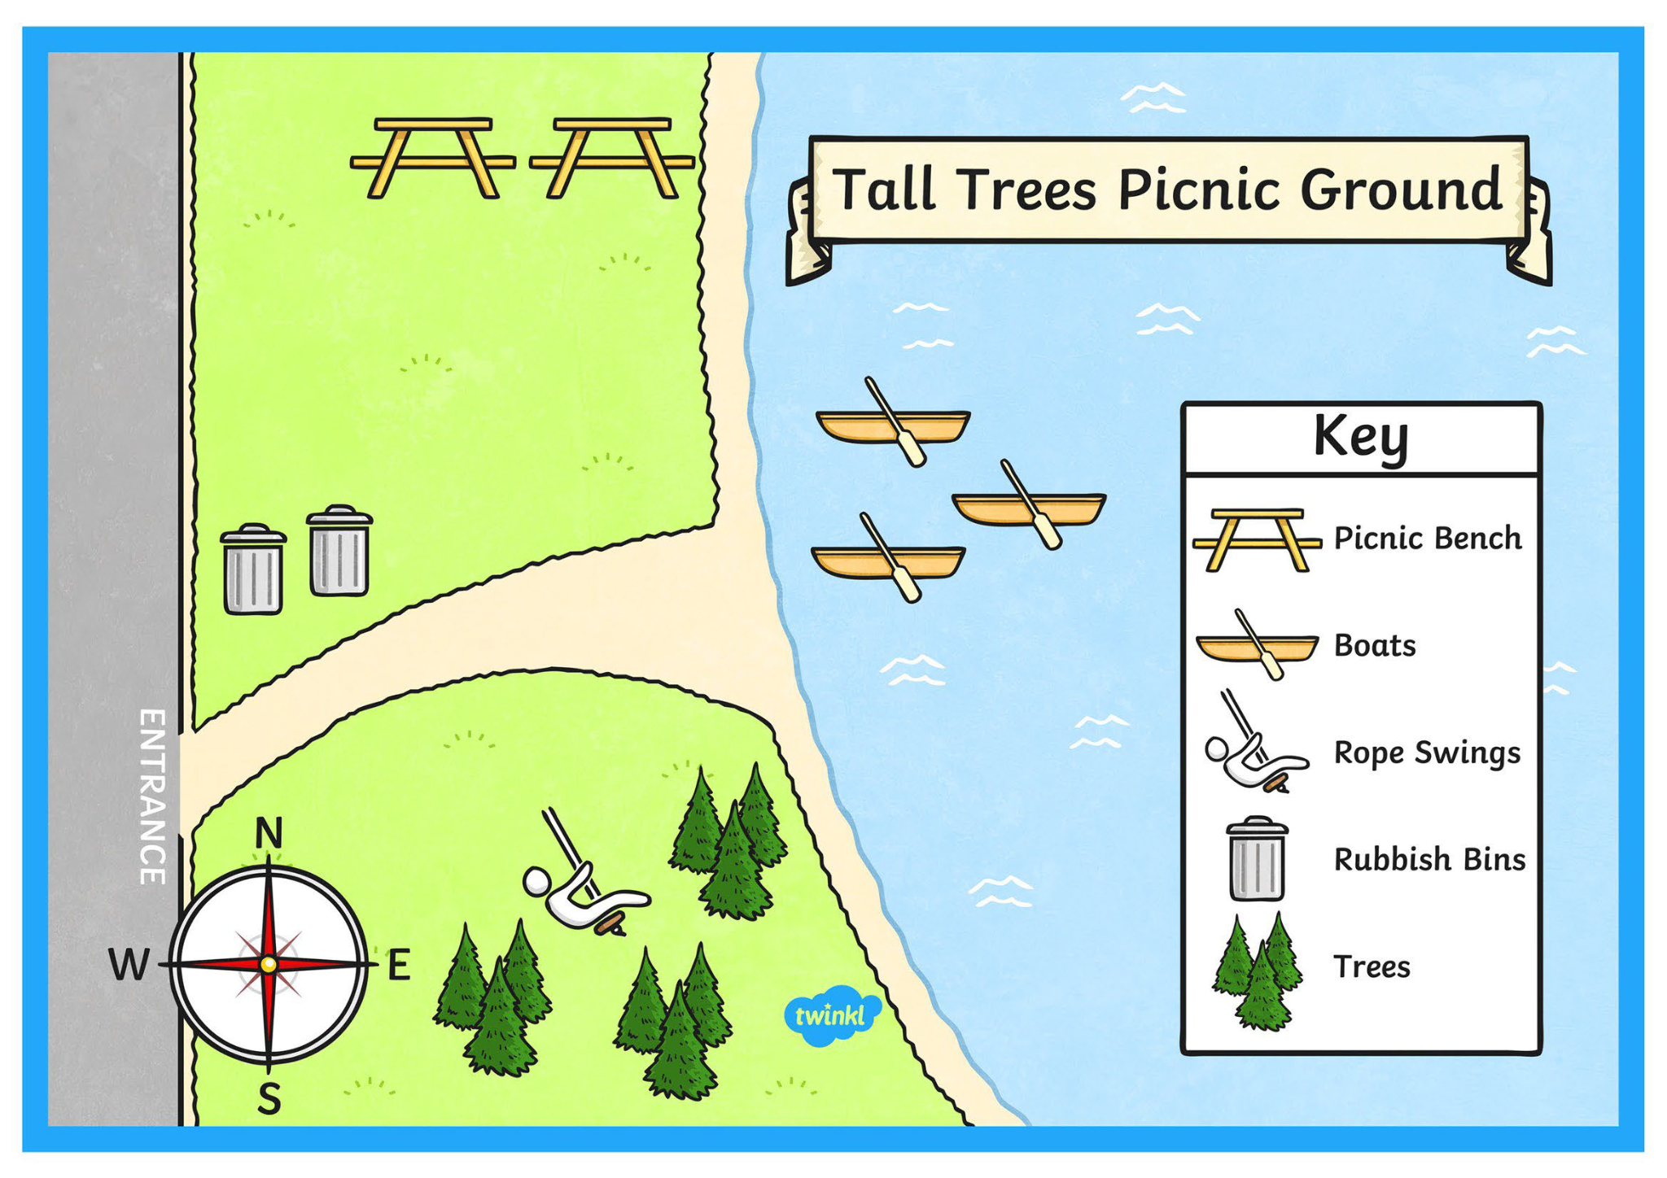
Places in a picnic area.
Where are the rubbish beans?
They’re at the entrance on the left.
Where are the pine trees?

Slide 8
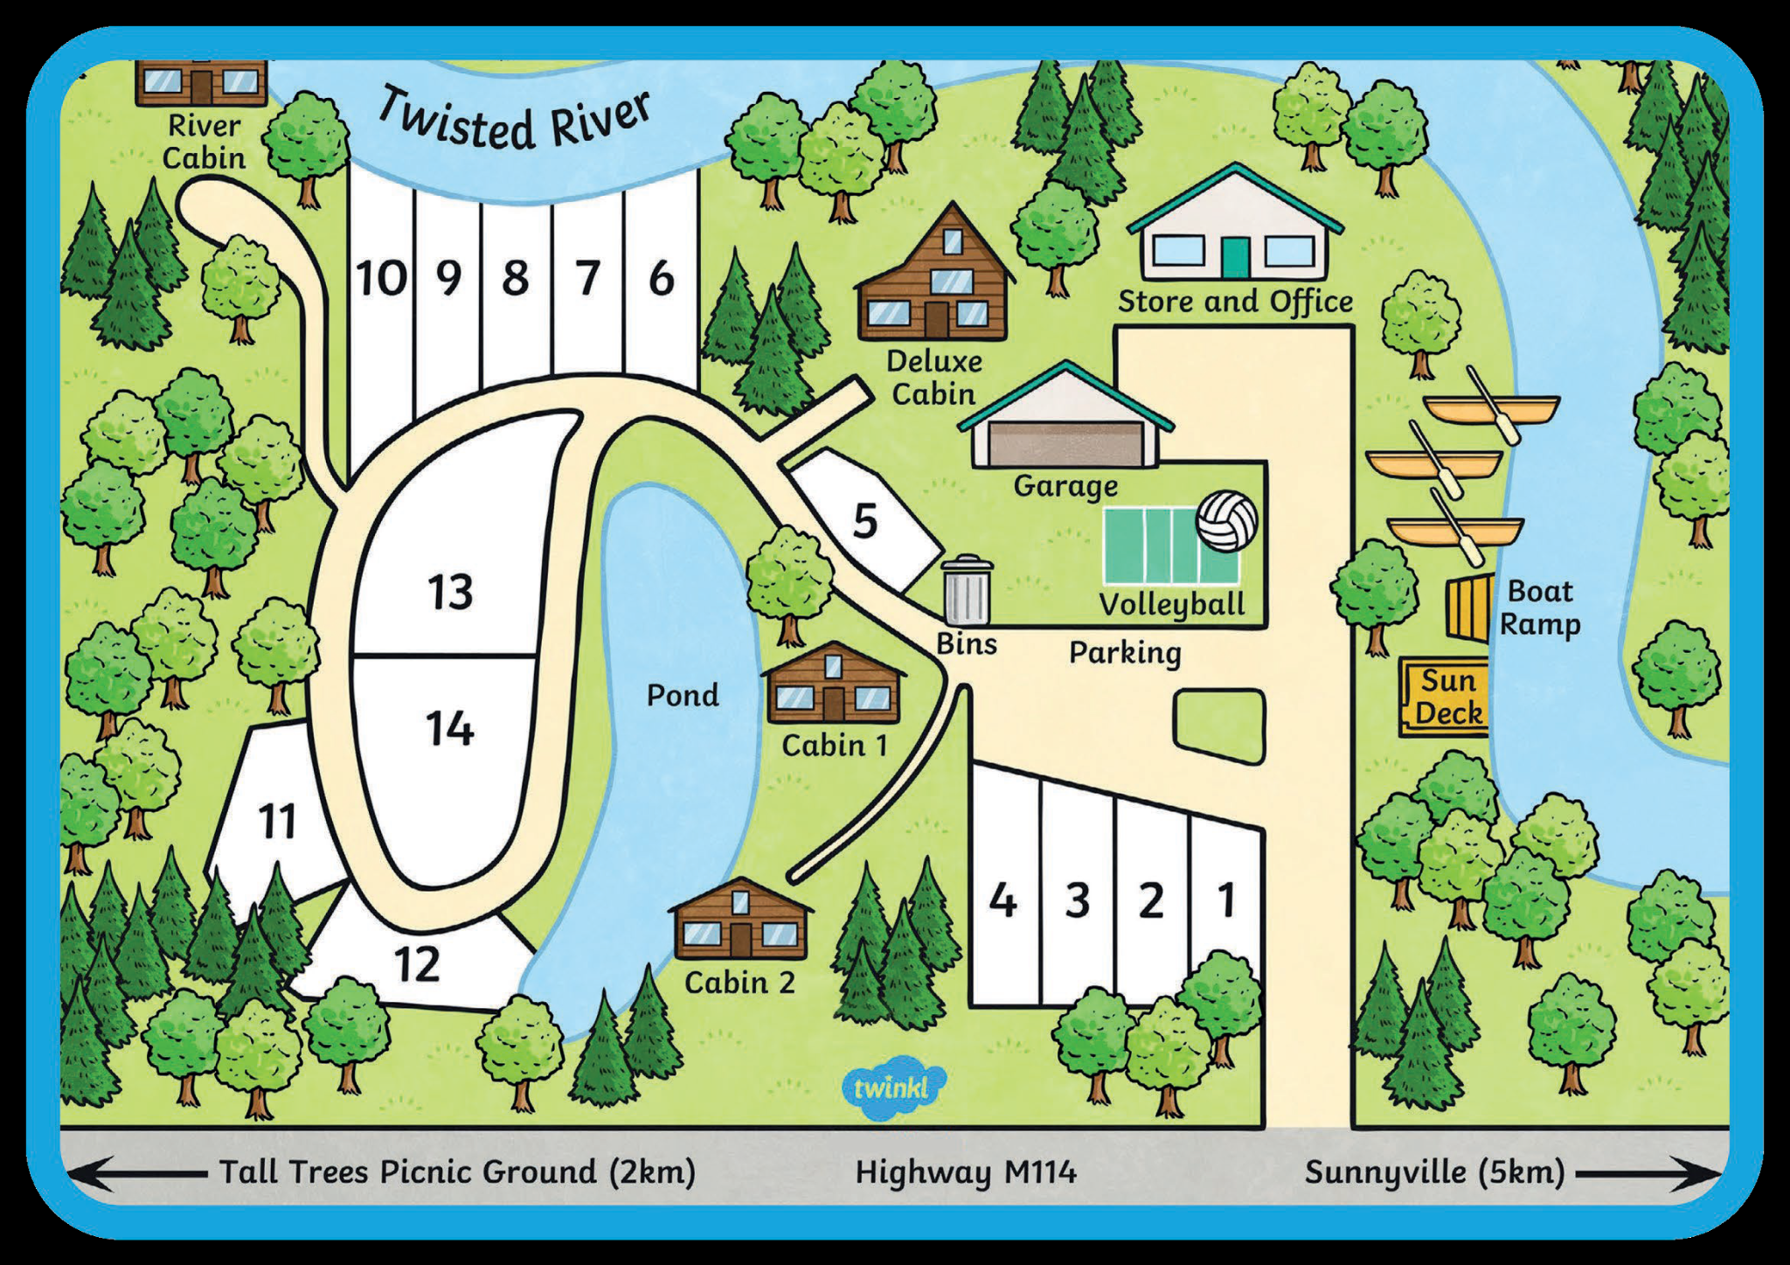
Places in Tourist Resort.
How can I get the boat ramp?
Go straight ahead on Main Street, go past the Sun deck, next to it, you’ll see the ramp by the river.
How can I get the volleyball court?

Slide 9

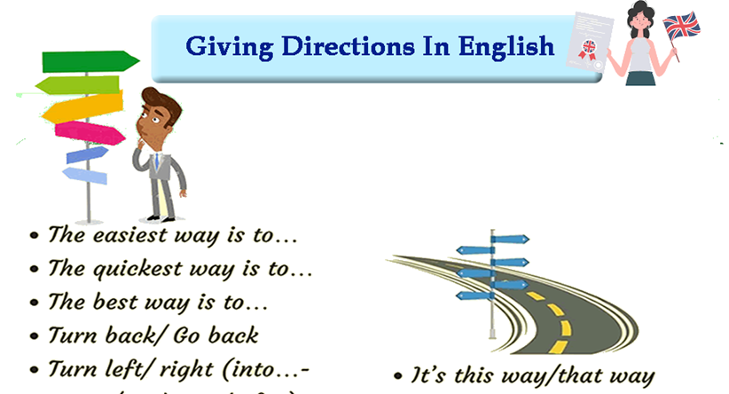
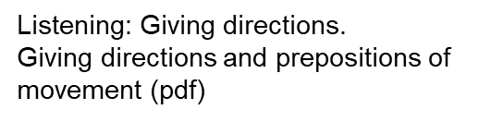
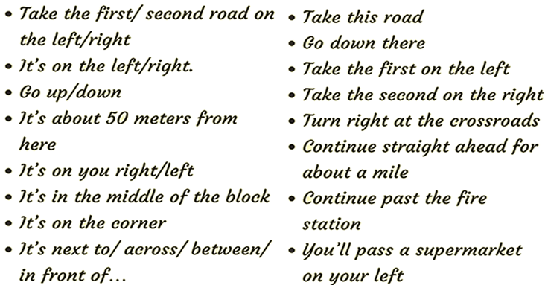
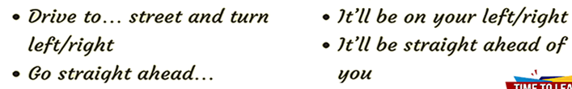

Slide 10
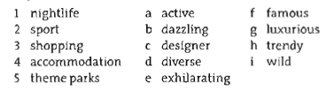
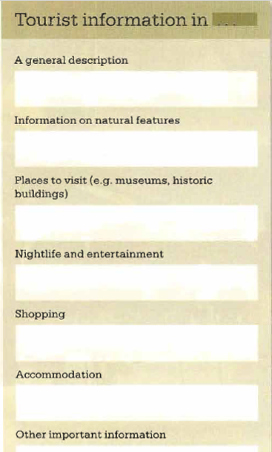

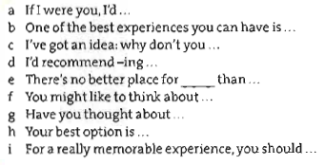
Adjectives to describe cities.
Give recommendations to visit your region. Use adjectives to describe it and phrases to promote it.
Phrases to recommend places.

