Slide 1

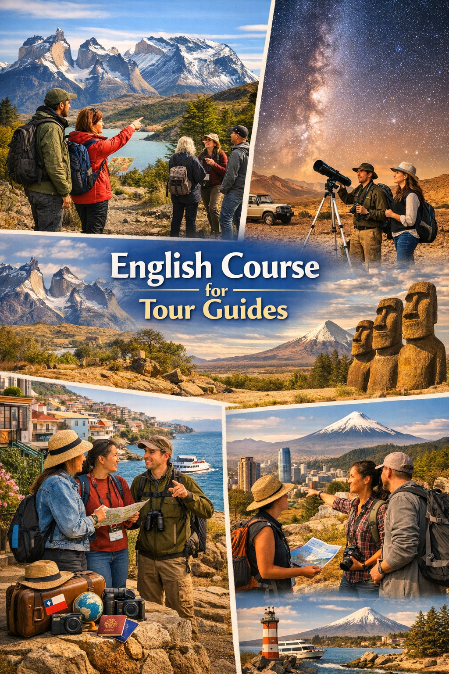
English for tour guides.
UNIT 1: RECIBIENDO Y SALUDANDO A TURISTAS
By Jeannete Uribe Guajardo.
CONTENTS OF THE LESSON:
What is Tourism?
Talk about personal skills and routines at work.
Personal past experiences.
SKILLS TO PRACTICE:
Reading
Listening
Speaking
Grammar in use.
Vocabulary in use.

Slide 2
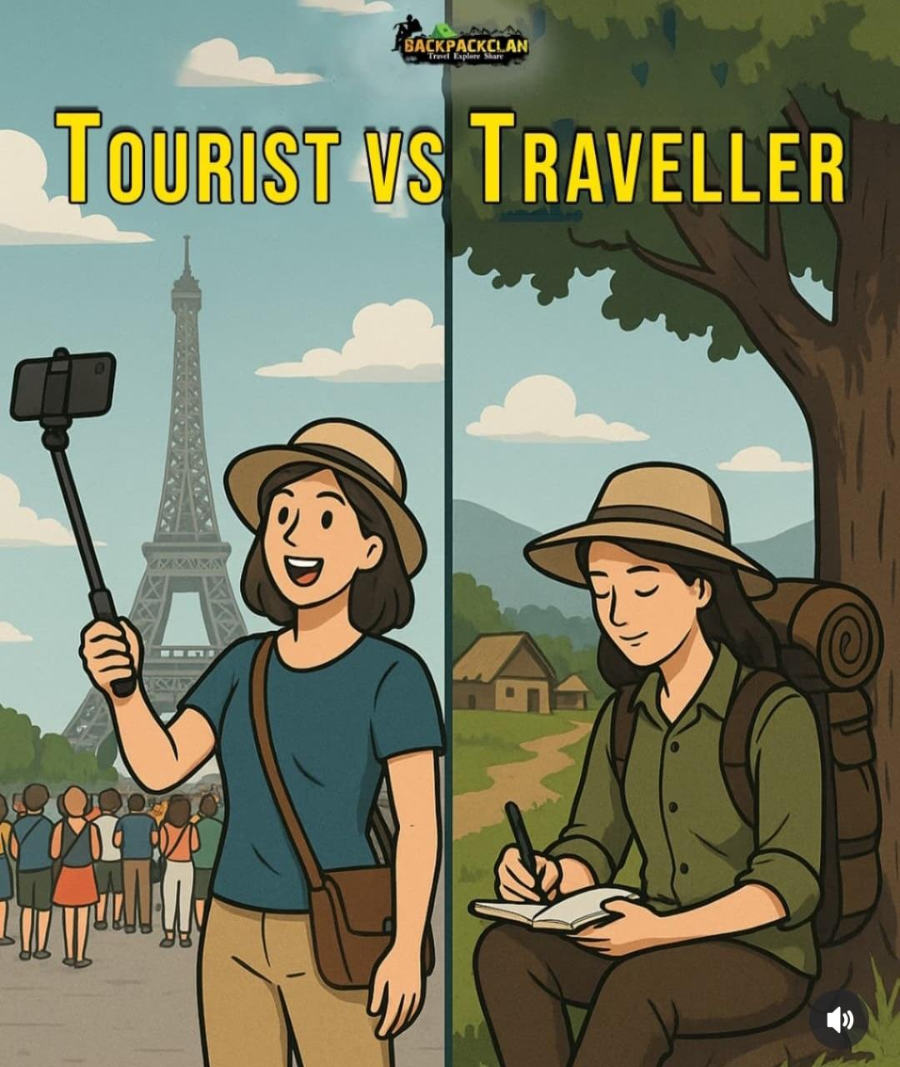
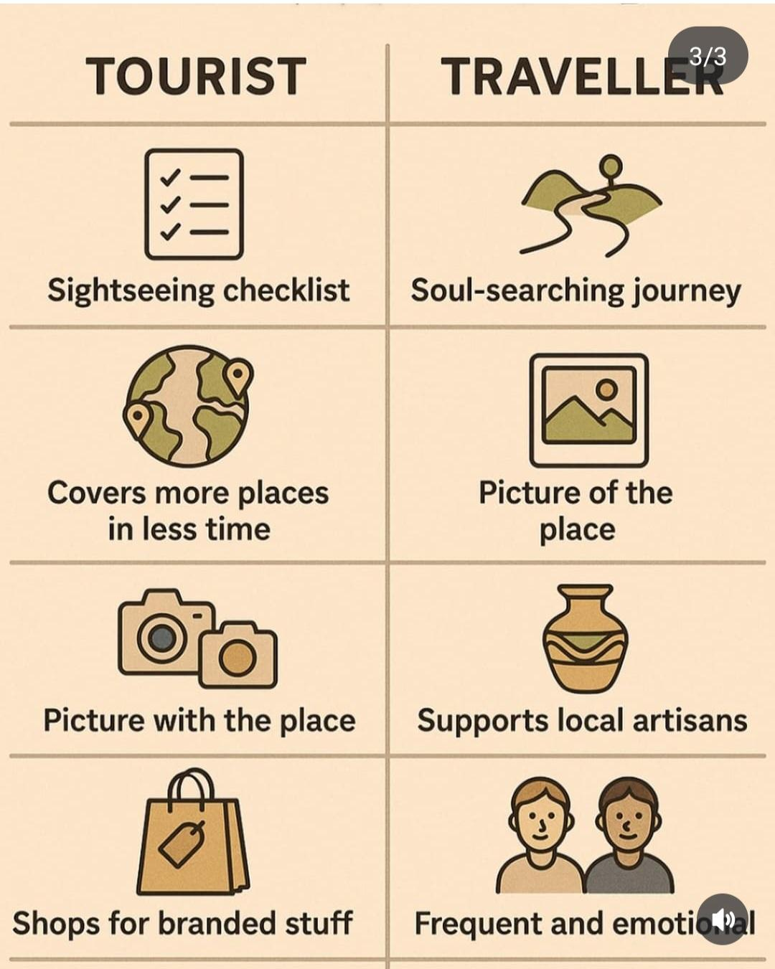


Slide 3
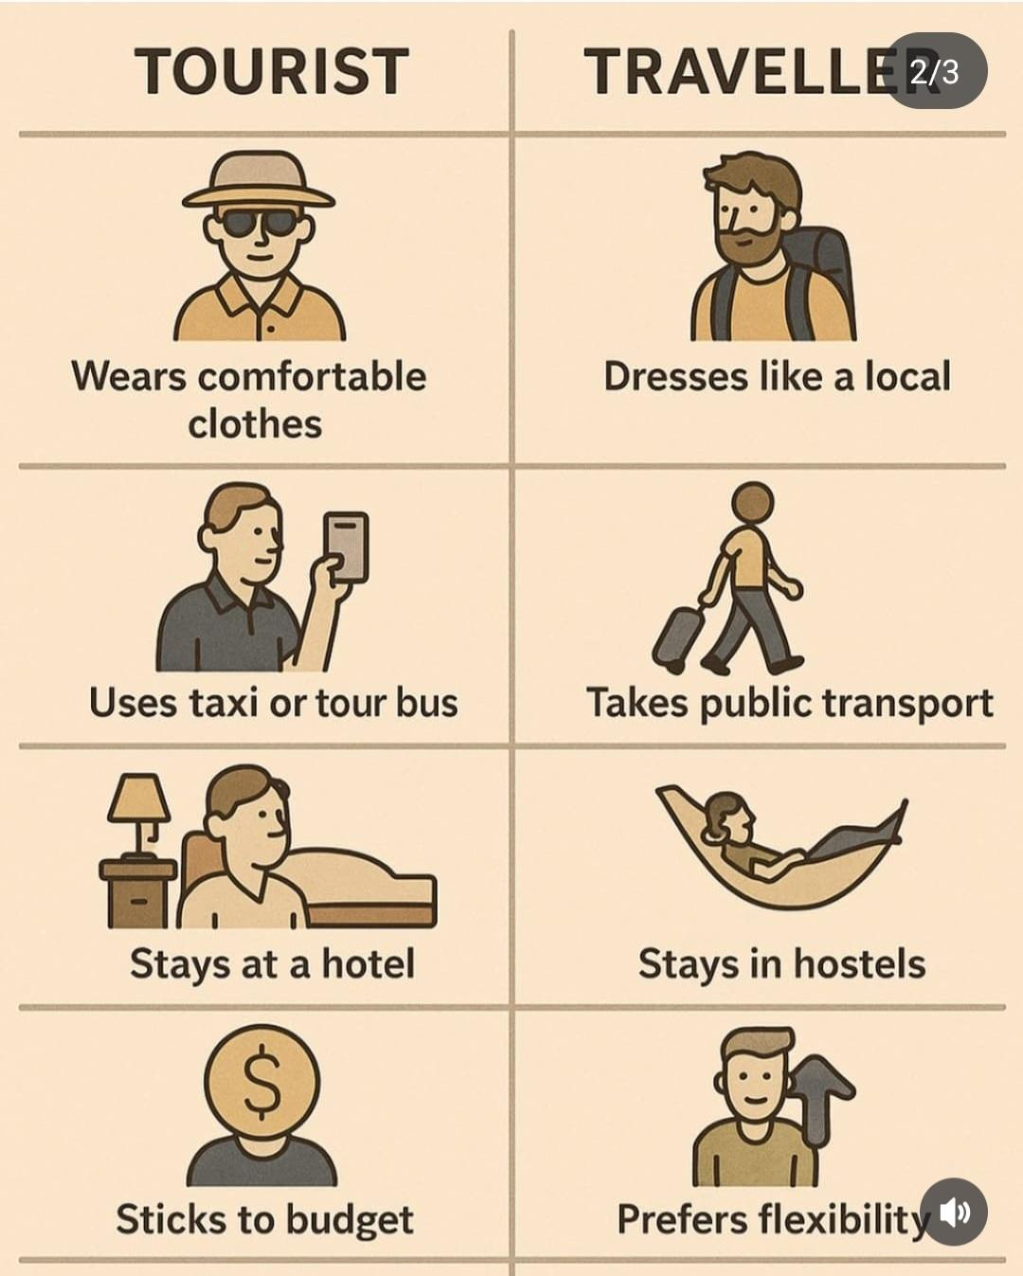

Slide 4

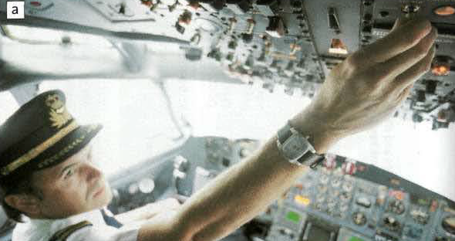

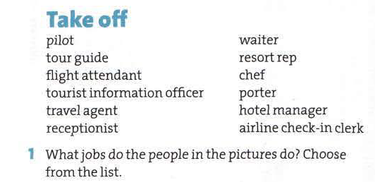
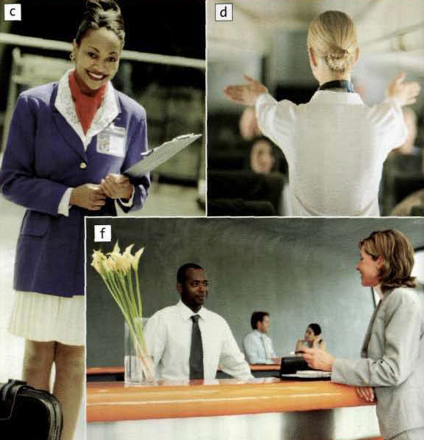
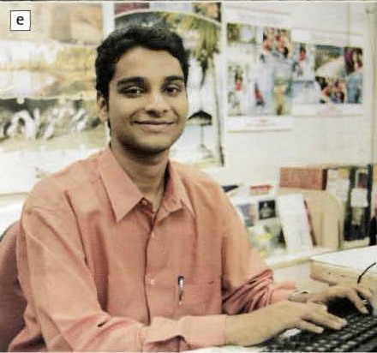
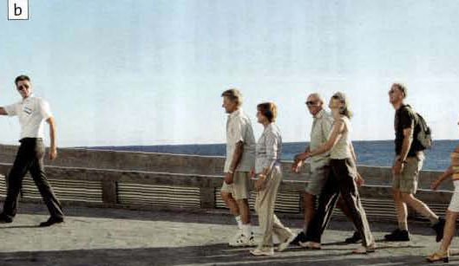

Slide 5

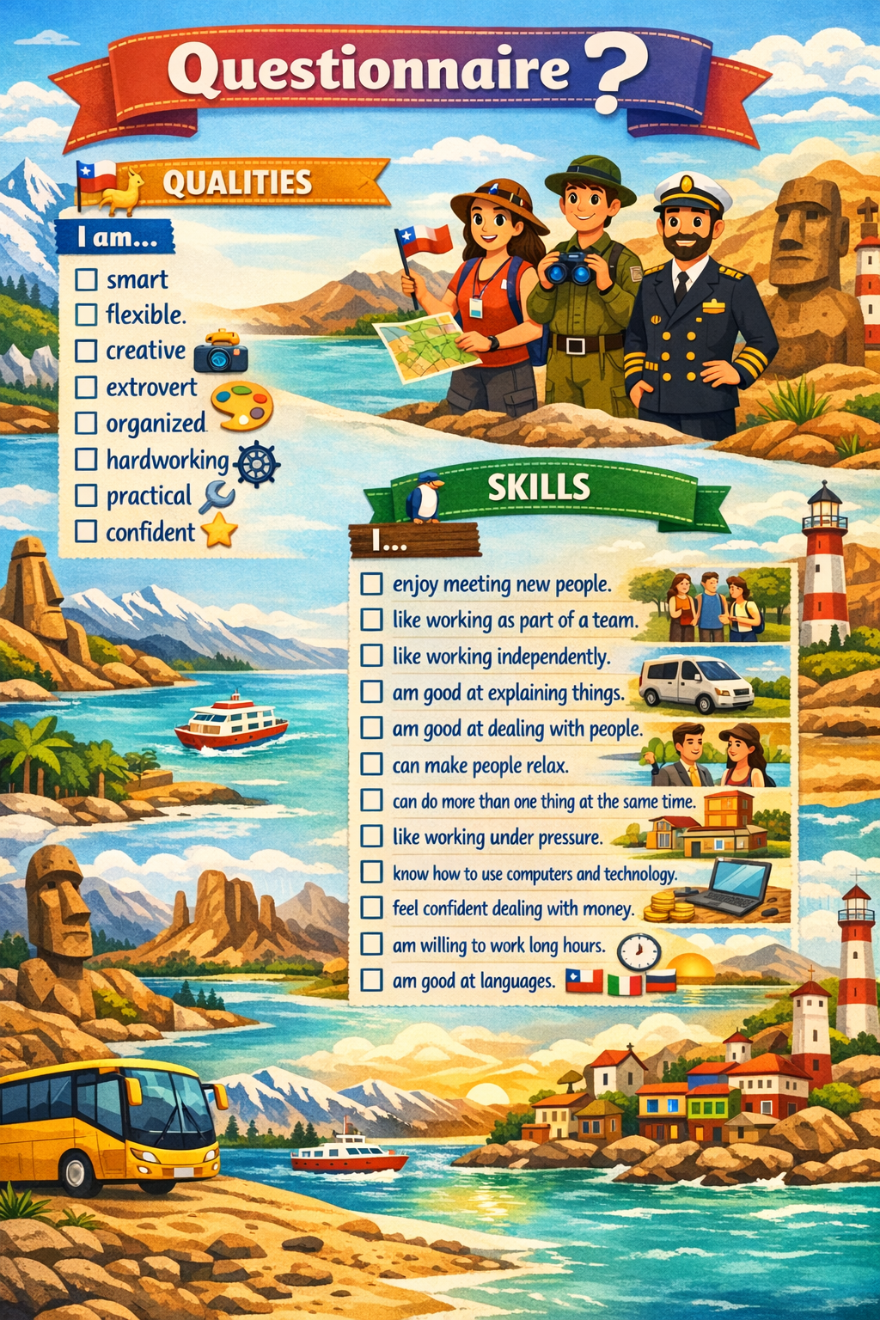
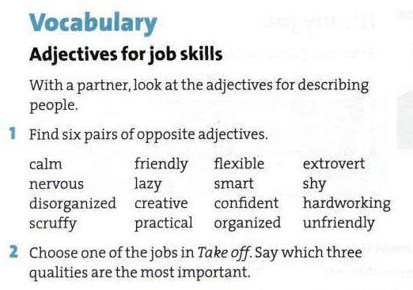
What are the main qualities or skills for a tour guide?

Slide 6
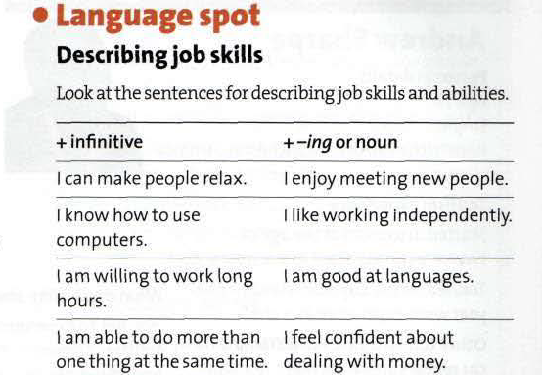
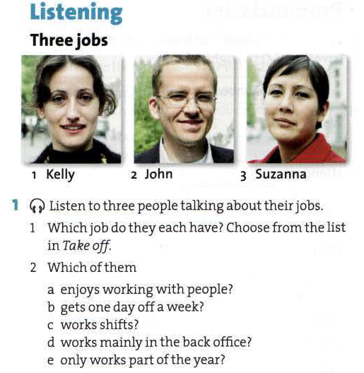
Describe your skills:

Slide 7
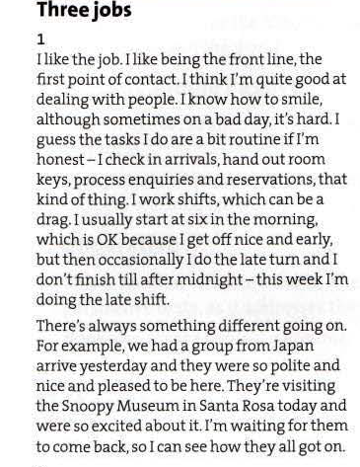
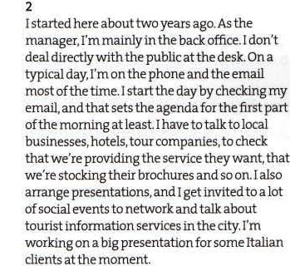
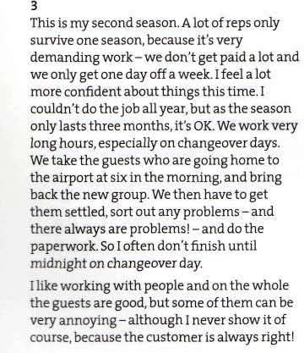
Listening “Three Jobs”.
Talking about routines at work.

Slide 8
Homework: Write a paragraph describing your job position, what you do at work (routines) and mention the qualities and skills you have. Read it or speak it in front of the class.

