Slide 1

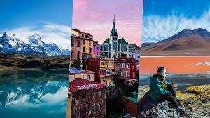
English for tour guides by Miss Jeannete Uribe G.
jeannete.uribe@lenguaagil.cl
Unit 2: Describiendo y recomendando destinos turísticos.
CONTENTS OF THE LESSON:.
Talking a little bit more about describing food.
Destinations, attractions and events of a place vocabulary.
SKILLS TO PRACTICE:
Reading
Listening
Speaking
Grammar in use.
Vocabulary in use.

Slide 2
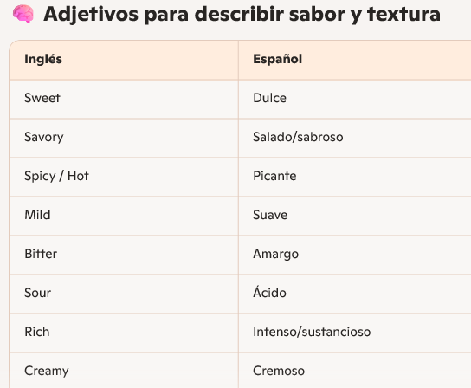
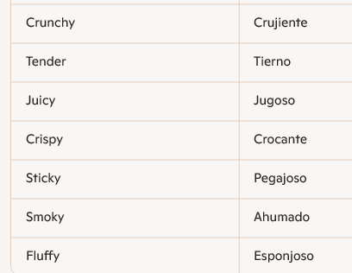

Slide 3
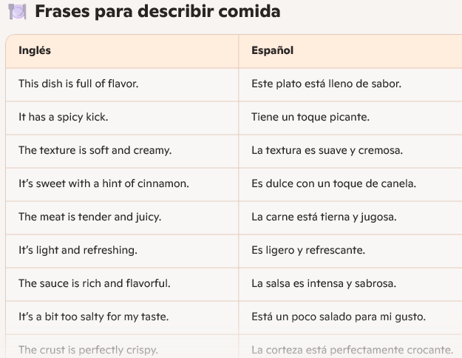

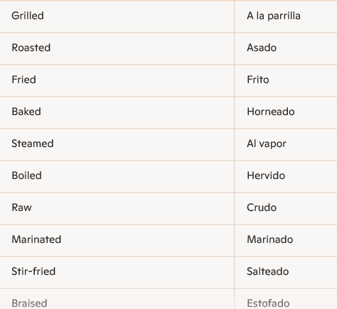

Slide 4
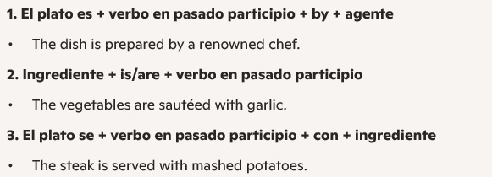
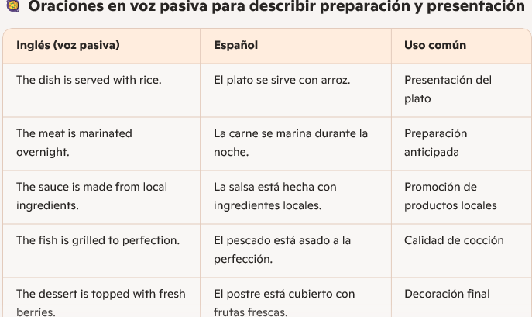
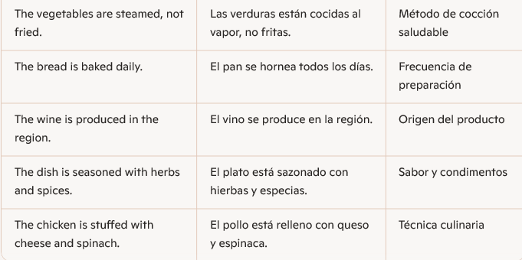
Subject + form of "to be" + past participle

Slide 5

Think of a local dish.
How would you describe it using passive voice?

Slide 6
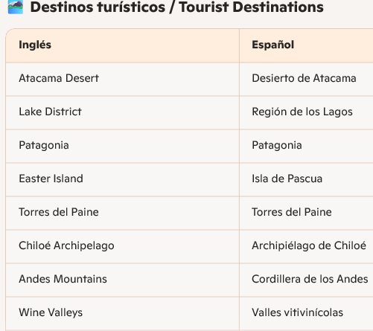
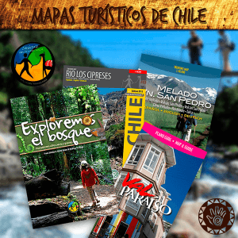
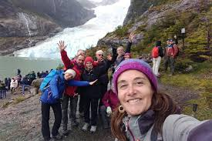

Slide 7
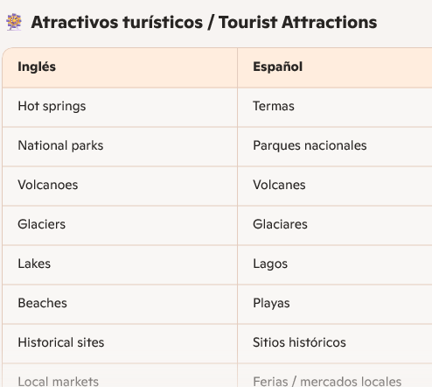
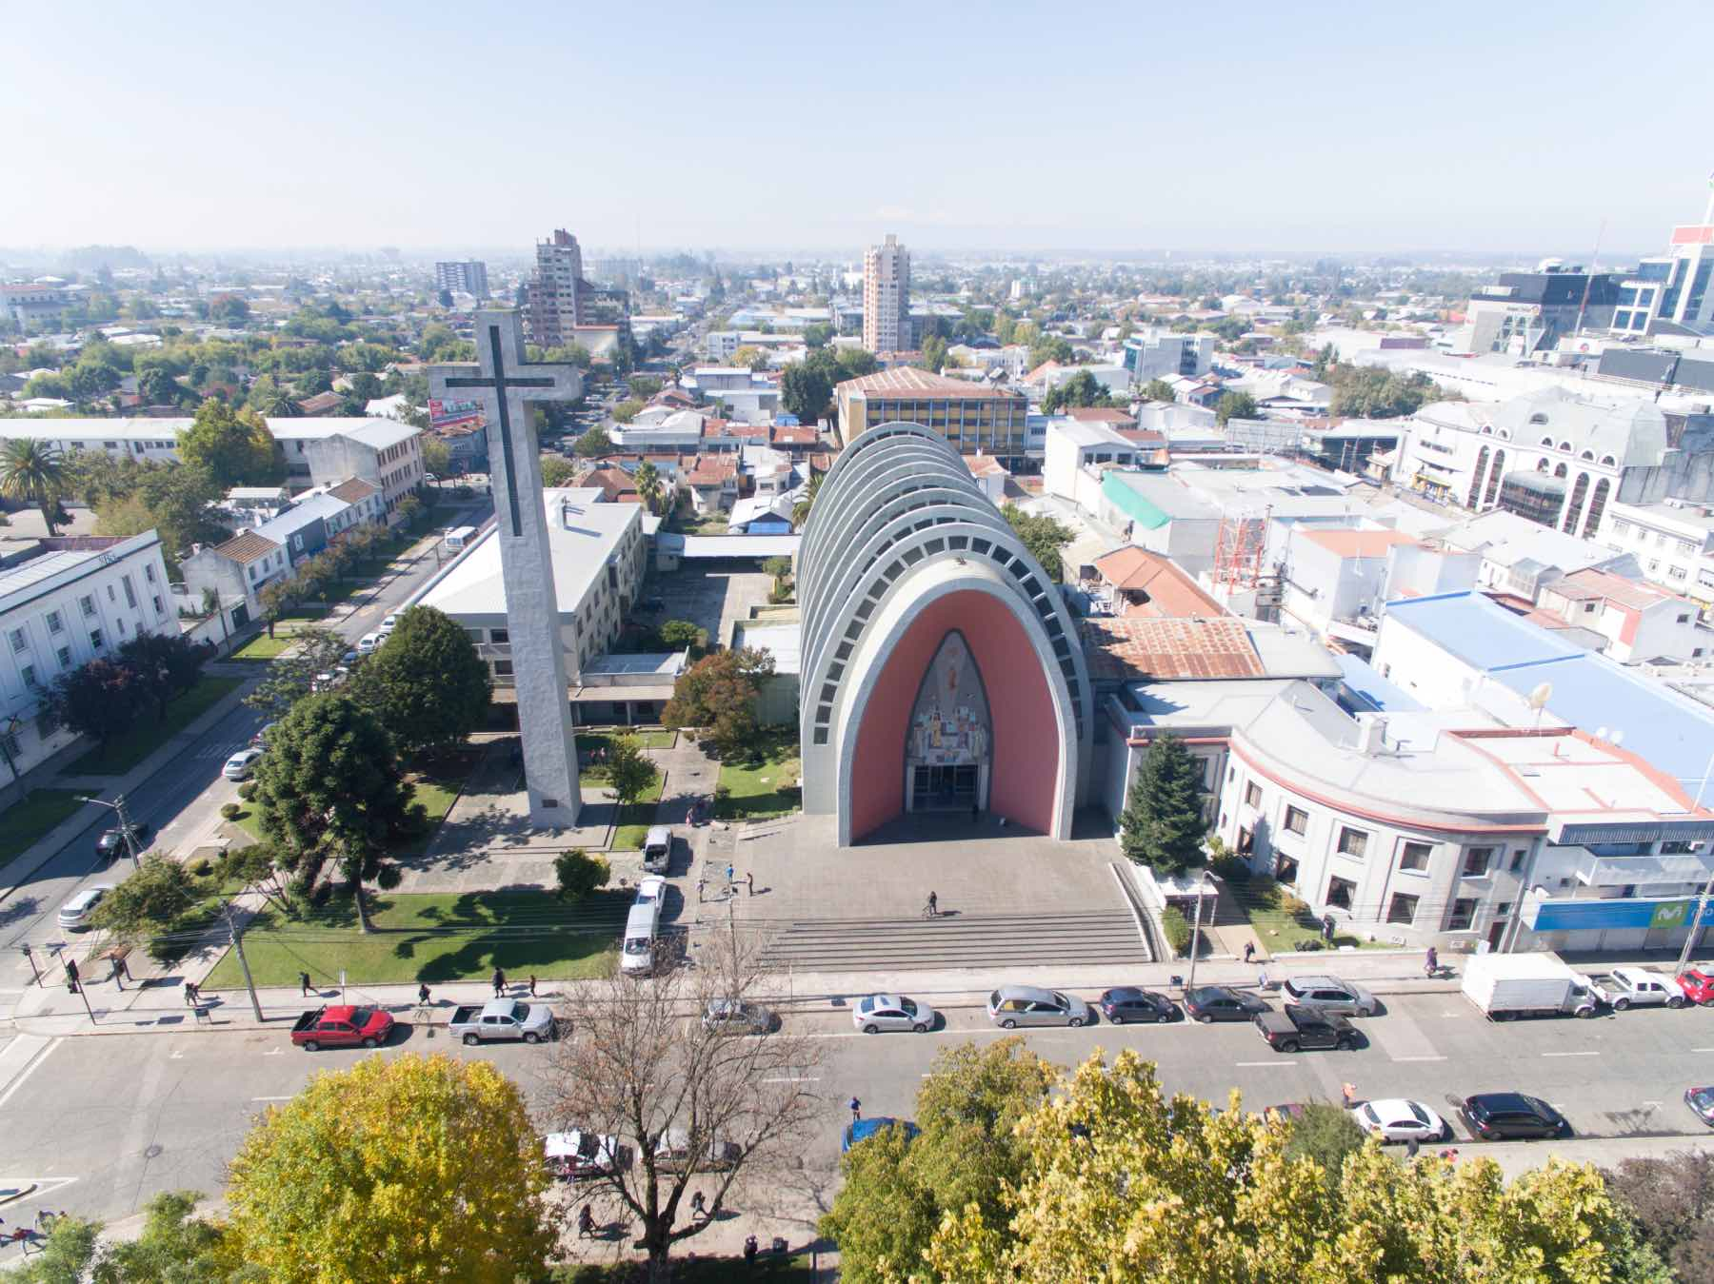
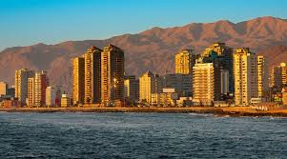
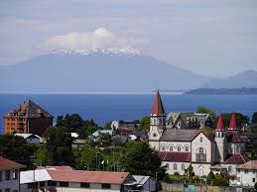


Slide 8
