Slide 1

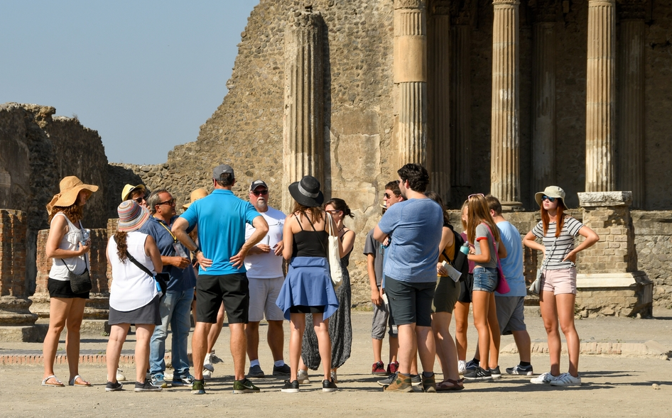
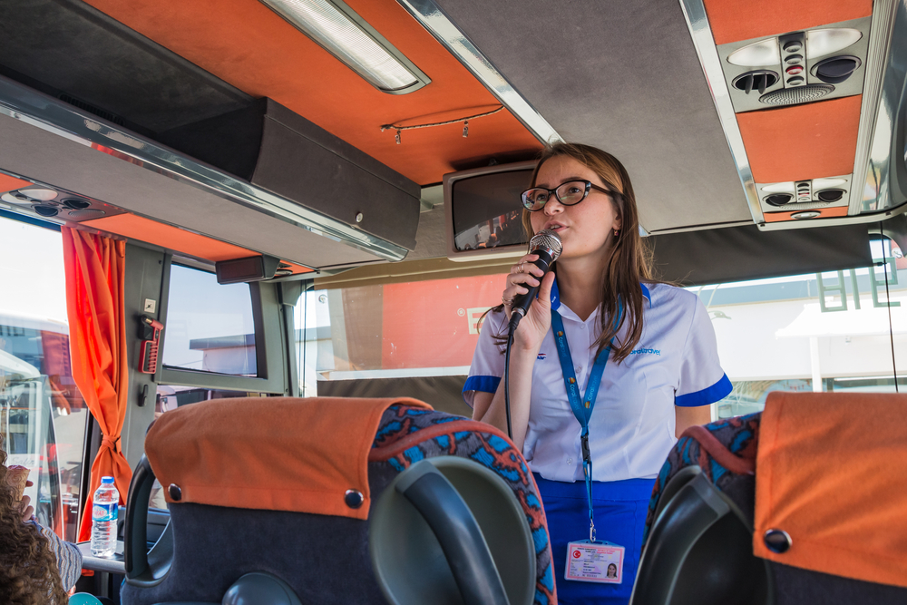

English for tour guides by Miss Jeannete Uribe G.
jeannete.uribe@lenguaagil.cl
Unit 3 Narración de guiados y medidas de seguridad.
CONTENTS OF THE LESSON:
Registering passengers.
Guiding the tour phrases.
Telling stories and anecdotes expressions.
Standard of performance.
Bonus track: Favourite places listening.
Instrucciones para evaluación final del curso.
SKILLS TO PRACTICE:
Reading
Listening
Speaking
Grammar in use.
Vocabulary in use.

Slide 2
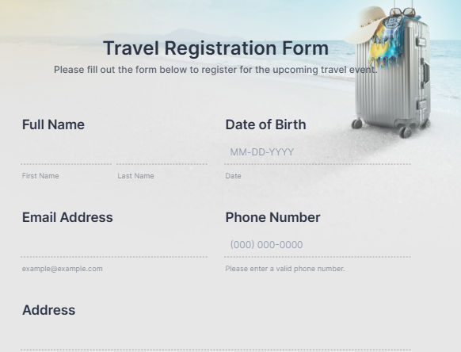
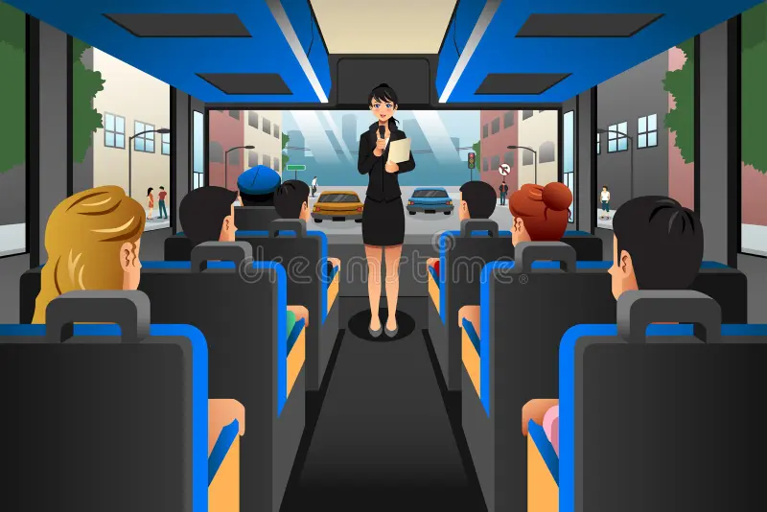
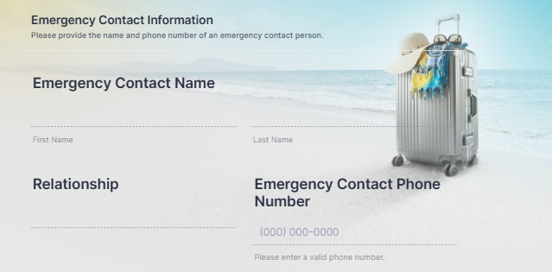

Slide 3
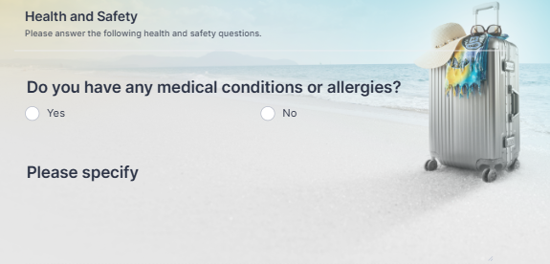


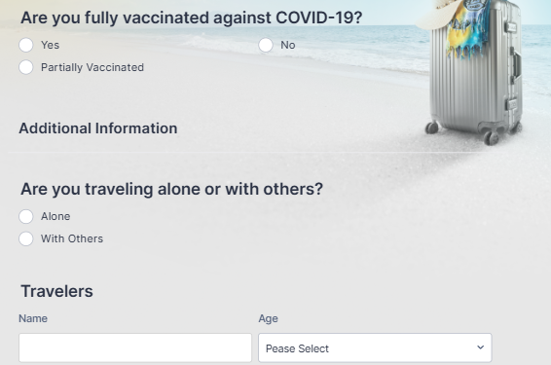
ver apuntes anexos

Slide 4
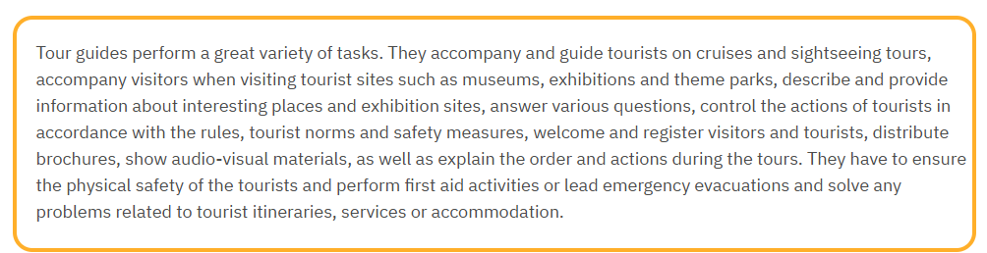
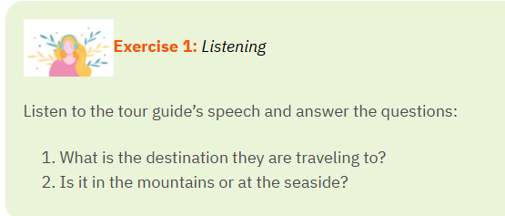

A tour guide’s speech.
Let’s listen to two monologues from a tour guide, and identify the phrases and answers.

Slide 5
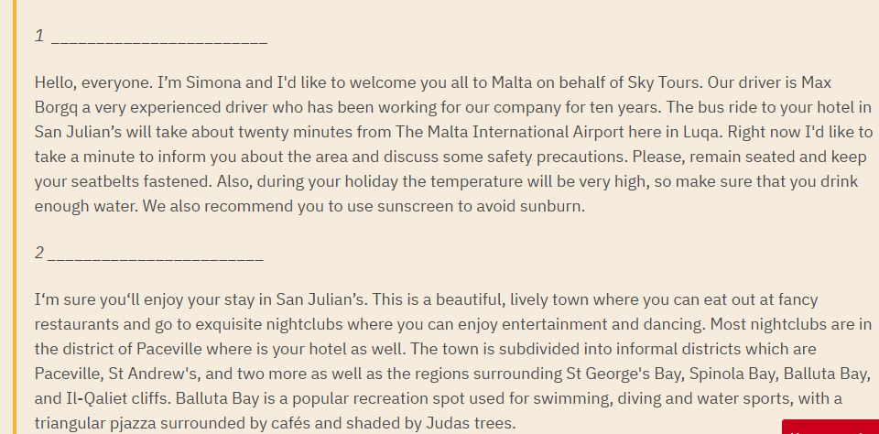

Highlighted expressions to use on a tour from the reading.

Slide 6

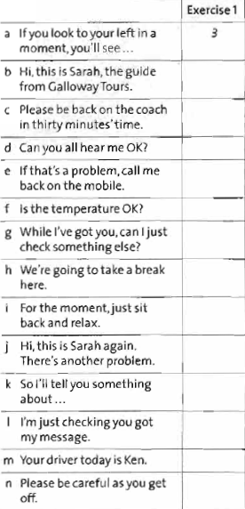
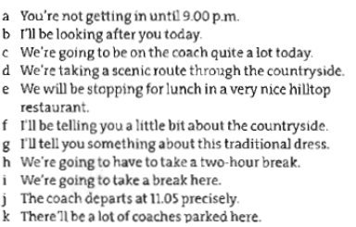
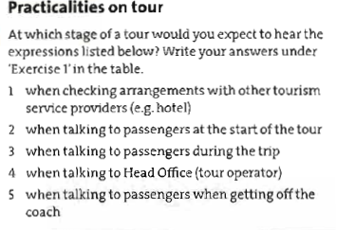
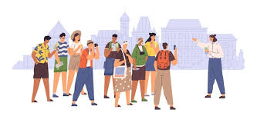
Use of future tenses:
Will + verb
Going to + verb
Present Continuous
Examples:
Ver apuntes anexos.

Slide 7
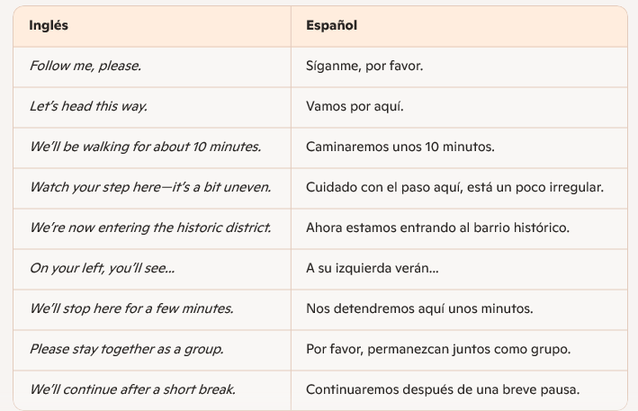
Can you mention any phrase you would use in this section?

Slide 8
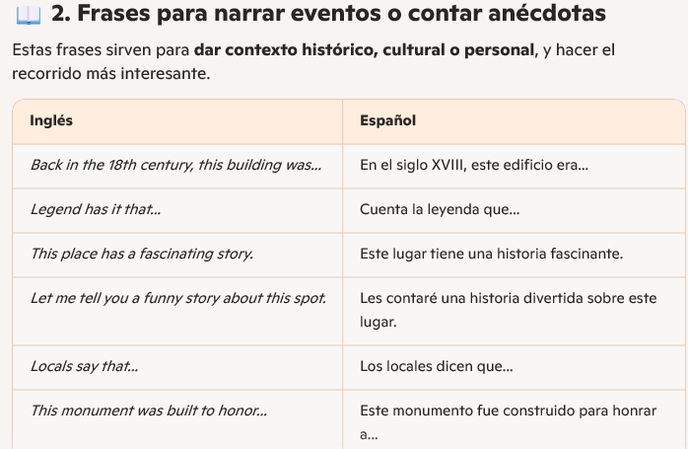
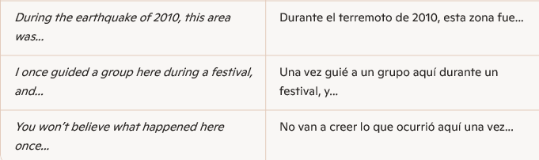
Can you mention any phrase you would use in this section?

Slide 9
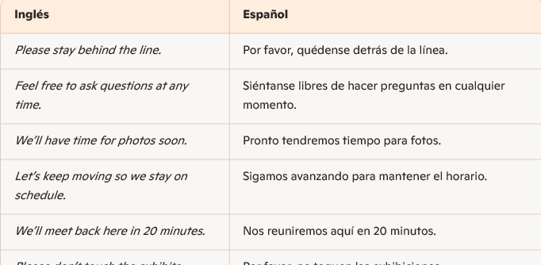
Can you mention any phrase you would use in this section?

Slide 10

