Slide 1


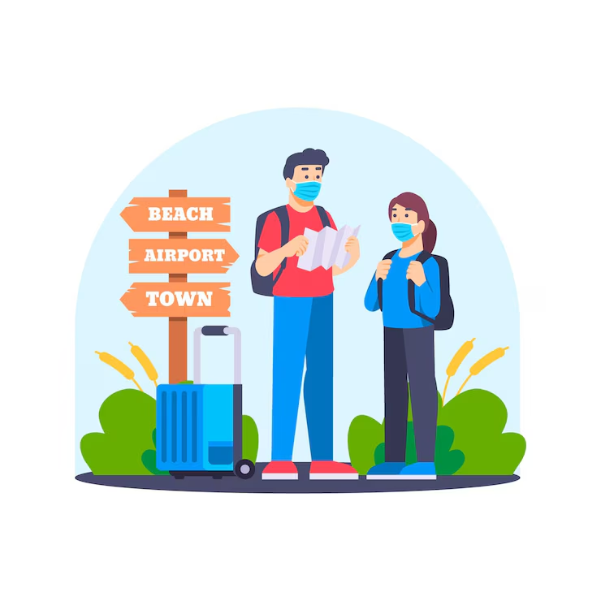

English for tour guides by Miss Jeannete Uribe G.
jeannete.uribe@lenguaagil.cl
Unit 3 Narración de guiados y medidas de seguridad.
CONTENTS OF THE LESSON:
Dealing with complaints.
Talking about security and how to be safe on tour
SKILLS TO PRACTICE:
Reading
Listening
Speaking
Grammar in use.
Vocabulary in use.

Slide 2
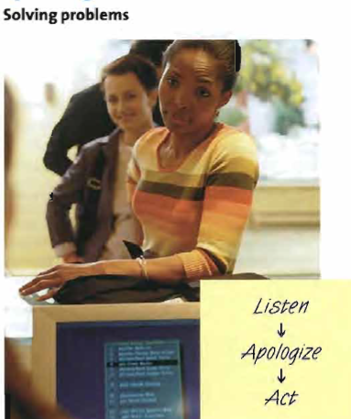
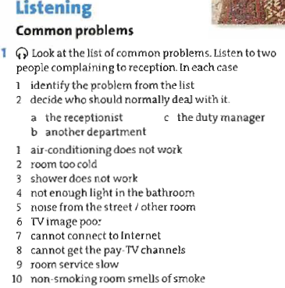

What would you have said in each situation?

Slide 3
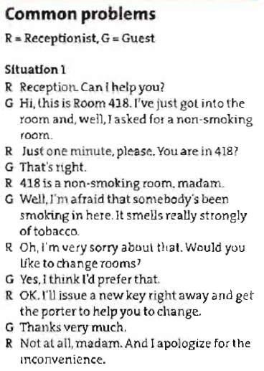
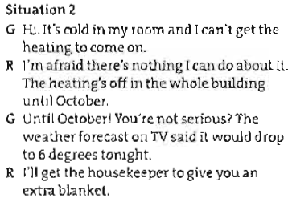
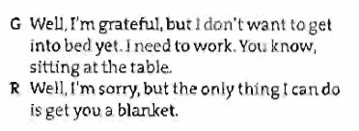

Slide 4
